Slide 1
Do more.
Be more.
Young Leaders’ Scheme
Scouts.org.uk
#SkillsForLife
Notes:
If you need to change the background please follow these instructions:
1. On your Windows tablet, tap the Design tab.
2. On your Windows phone, open the slide for editing (either by double-tapping it or by tapping it and then tapping Edit). Tap More at the bottom of your screen, tap Home, and then tap Design.
3. Tap Format Background.
4. You will see the background colours divided into Theme Colours and Standard Colours. Theme colours coordinate with the theme you selected previously. You can select a solid colour or colour gradient.

Slide 2
Explorer Scout Young Leader Training
Module K – First Aid

Slide 3
Do more. Be more
Welcome
The objectives of this module are that of the course undertaken or the qualification obtained (see below) Explorer Scout Young Leaders need to do one of these to complete this module:
attend a First Response course
gain Stage 4 of the Emergency Aid Staged Activity Badge
gain the Lifesaver Activity Badge for the Explorer Scout section
gain any other equivalent qualification in agreement with the Explorer Scout Leader (Young Leader)
Do more.
Be more.
Young Leaders’ Scheme

Slide 4
Getting to know you...
Notes:
Icebreaker: 5- 10 mins
Key points:
Participants will be working together during the session so it's a good idea to break the ice and get to know each other first.
Activity option 1 - Speed dating:
Everyone walks around the room, finds someone they don’t know and talk for 1 minute
Ask questions: Who got you into Scouts? When did you join Scouts? What key skill do you bring to your Scout team? what they’d like to learn from workshop,
After two minutes, blow a whistle or shout and they find a new partner
Presenters can come up with other questions if they can think of better ones!
Or alternatively depending on amount or type of participants
Activity option 2 – Group discussion
Participants to discuss above questions (from option 1) within their table groups

Slide 5
Why do we cover First Aid?
This module aims to ensure that Explorer Scout Young Leaders have the understanding and skills to act in an emergency.
Training in emergency response is becoming an essential requirement for many jobs and courses. These skills are invaluable for Explorer Scout Young Leaders . That’s why training in emergency aid is part of the Scheme.
Given the wide availability of training courses in first and emergency aid, Explorer Scout Young Leaders complete this module by attending a recognised training course.

Slide 6
Option 1: attend a First Response course
Notes:
Provide information for the Explorer Scout Young Leaders on when these courses take part, how to sign up, who to contact etc.

Slide 7
Option 2: Stage 4 of the Emergency Aid Staged Activity Badge
Notes:
Provide information for the Explorer Scout Young Leaders on how to complete the badge, the requirements, sections where they can complete it etc.
https://www.scouts.org.uk/staged-badges/emergency-aid/stage-4

Slide 8
Option 3: Lifesaver Activity Badge for the Explorer Scout section
Notes:
Provide information for the Explorer Scout Young Leaders on how to complete the badge, the requirements, sections where they can complete it etc.
https://www.scouts.org.uk/explorers/activity-badges/lifesaver/

Slide 9
Option 4: Equivalent qualification in agreement with the Explorer Scout Leader (Young Leader)
Notes:
There might be some qualification that an Explorer Scout Young Leaders has completed outside of Scouting that involved First Aid.

Slide 10
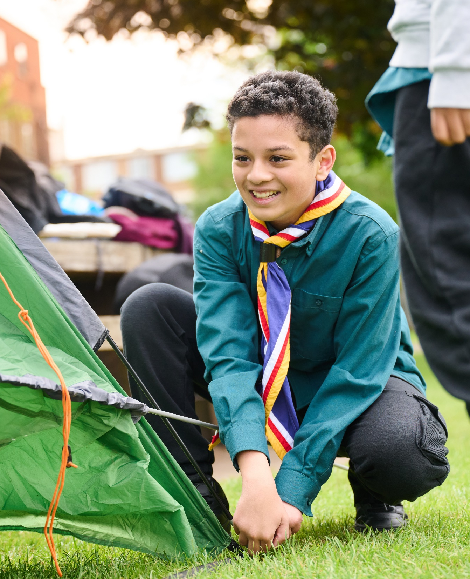
The Young Leader Scheme
Who to contact
If you have any questions, please contact the following people who will be able to help you.
Enter details of County/District contacts here

Slide 11
Thank you
Young Leaders’ Scheme
Scouts.org.uk
#SkillsForLife

