Slide 1
Do more.
Be more.
Young Leaders’ Scheme
Scouts.org.uk
#SkillsForLife
Notes:
If you need to change the background please follow these instructions:
1. On your Windows tablet, tap the Design tab.
2. On your Windows phone, open the slide for editing (either by double-tapping it or by tapping it and then tapping Edit). Tap More at the bottom of your screen, tap Home, and then tap Design.
3. Tap Format Background.
4. You will see the background colours divided into Theme Colours and Standard Colours. Theme colours coordinate with the theme you selected previously. You can select a solid colour or colour gradient.

Slide 2
Explorer Scout Young Leader Training
Module I – What did they say?

Slide 3
Do more. Be more
Welcome
By the end of the module, you’ll:
understand why it's important to get feedback and input from young people in the section
list different ways you can gather ideas and feedback within your section
explain how you can bring your section’s ideas to life and make adaptations where necessary
Do more.
Be more.
Young Leaders’ Scheme

Slide 4
Getting to know you...
Notes:
Icebreaker: 5- 10 mins
Key points:
Participants will be working together during the session so it's a good idea to break the ice and get to know each other first.
Activity option 1 - Speed dating:
Everyone walks around the room, finds someone they don’t know and talk for 1 minute
Ask questions: Who got you into Scouts? When did you join Scouts? What key skill do you bring to your Scout team? what they’d like to learn from workshop,
After two minutes, blow a whistle or shout and they find a new partner
Presenters can come up with other questions if they can think of better ones!
Or alternatively depending on amount or type of participants
Activity option 2 – Group discussion
Participants to discuss above questions (from option 1) within their table groups

Slide 5
Do more. Be more
As an Explorer Scout Young Leader, are you involved in the planning of the programme?
How were you asked?
Do you think you were listened to?
Do you think it's important to ask young people what they think?
What are the positives and negatives of asking young people? Is it appropriate for all sections?
What do you feel are the benefits of young people feeling empowered to plan their programme?
Notes:
Ask Explorer Scout Young Leaders if they were involved in the planning of their programme:
How were they asked?
Do they think they were listened to?
Do they think it's important to ask young people what they think?
What are the positives and negatives of asking young people? Is it appropriate for all sections?
2. Initiate a discussion about why it's important to practice Youth Shaped Scouting. What are the benefits of young people feeling empowered to plan their programme?

Slide 6
Snowball fight!
Notes:
Give each Explorer Scout Young Leader a piece of paper. On it, they should write down one activity they could use to gather feedback from young people.
Once they have written down their ideas, they should screw the paper to make snowballs.
Let the snowball fight commence!
After a few minutes, ask the Explorer Scout Young Leaders to freeze and pick up the snowball closest to them.
Go around the group reading each idea aloud. This should bring up lots of different ideas you could use to gather feedback from young people.
Go over the following points together:
It's important that young people shape their own programme and have input planning and running it.
You can run a forum as to get specific feedback or to gather young people’s ideas for planning.
You can run a simple activity at the end of a session to evaluate the session you have just completed.
The best way to get feedback is to make it fun, interactive and embedded into the programme.
Once you have ideas and feedback from young people it's important that you use them.
Plan them into the programme. Better yet, support the young people to bring their ideas to life themselves. This teaches them valuable life skills.
Top tip: There are lots of ideas for running Youth Shaped sessions with different sections, for ideas on youth shaped programme activities, take a look through our activity finder.

Slide 7
Idea generation
Notes:
Split the group into four teams and set up four bases (or breakout rooms if online)
Place different objects or materials at each base.
Give the Explorer Scout Young Leaders five minutes at each base to come up with an activity that encourages feedback from young people, using the different materials provided.
At the final base, ask each team of Explorer Scout Young Leaders to run one of the activities they have come up with.

Slide 8
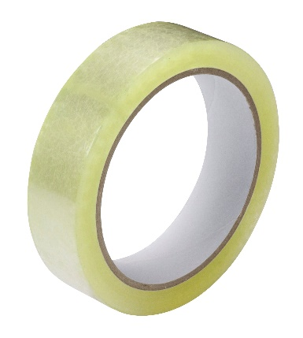
Base 1
Your materials are:
Notes:
Ideas that could come out of this are:
Running a night that teaches them about democracy – each young person can vote in a ballot box for the badge they want to work on in the next term
Ideas box in which young people can submit ideas on what to do

Slide 9
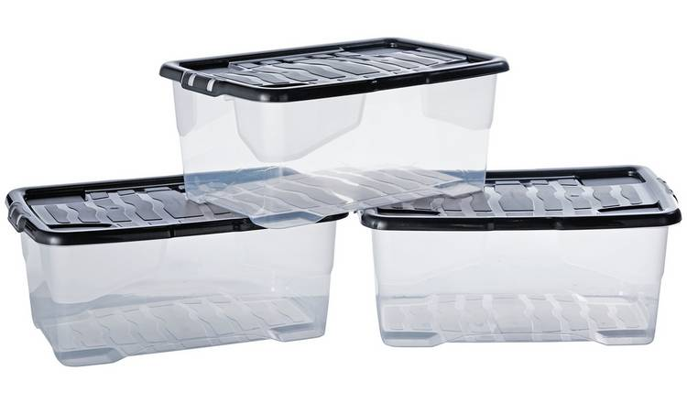
Base 2
Your materials are:
Notes:
Ideas that could come out of this are:
Asking for feedback on how a meeting went using a red coloured ball for not good, orange ball for ok, and green ball for amazing and ask them to put into a respective box
Similarly you could use this coloured ball system for voting on ideas

Slide 10
Base 3
Your materials are:
Notes:
Ideas that could come out of this are:
Snowball fight like you have just done
Give Scouts opportunities to plan their own programmes, such as by getting them to create their dream Scout term or camp
Draw up a new game that you can play as a section

Slide 11
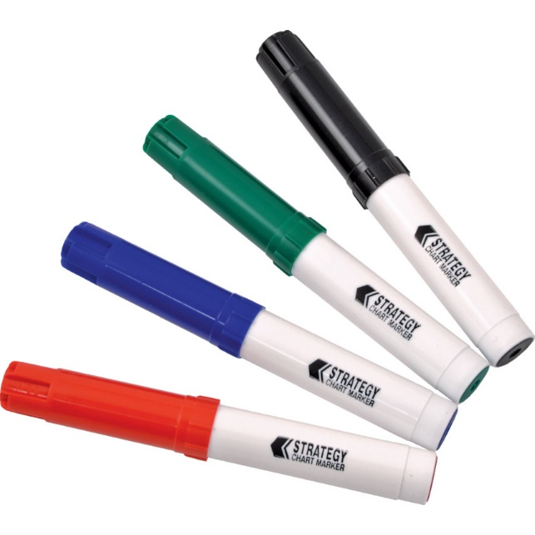
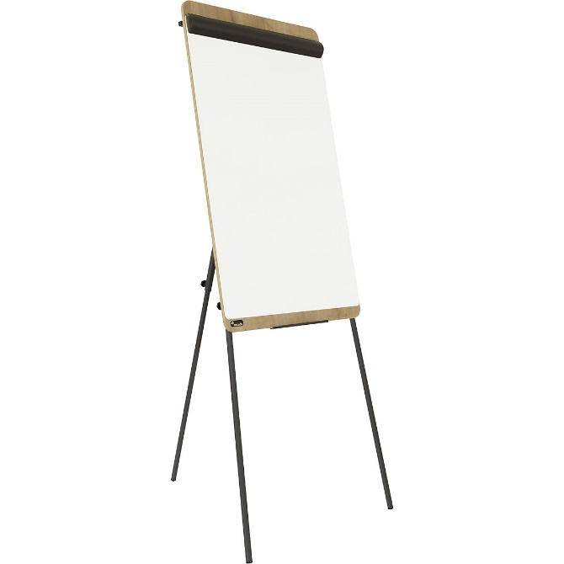
Base 4
Your materials are:
Notes:
Ideas that could come out of this are:
Run a focus group of Patrol Leader, Sixers and Seconders asking for ideas on what they would like to do.
Split the section into groups and ask them to generate ideas for a camp or day out on the flipchart. They can then present them back to the group

Slide 12
Bringing your ideas to life

Slide 13
Do more. Be more
Is it possible to turn these ideas into a reality?
Squirrel Scouts who want to go into space
Beaver Scouts who want to climb Everest
Cub Scouts who want to camp in a rainforest
Scouts who want to go skydiving
If so, how can you make these ideas happen?
If not, can you offer something similar?
Discuss how you might bring these ideas to life
Notes:
Ask the Explorer Scout Young Leaders to get into groups based on the section they support. Give each Explorer Scout Young Leader a scenario from below, or create your own. Suggestions include:
Squirrels who want to go into space
Beaver Scouts who want to climb Everest
Cubs who want to camp in the rainforest
Scouts who want to go skydiving
Ask the Explorer Scout Young Leaders if it’s possible to turn these ideas into a reality. If so, how can you make these ideas happen? If not, can you offer something similar? Discuss how you might bring these ideas to life.
If your Squirrels want to go into space, find out if there is a fun and easy way to inspire them with space themed activities, or a visit to a local space centre. You could look on the Activity Finder for space themed activities for the Squirrels to learn about space travel, and what gravity is, or get them to make their own rockets.
If your Beaver Scouts want to climb Everest, find out how far the distance would be. They may not be able to visit Everest itself, but they could cover the equivalent distance between them on a hike. Learn about the area and the terrain. Discuss what you would need to take with them, and pack a bag with the right kit. Talk about what you would need to know and learn and start that journey. You could find out the highest point in the County and pledge to climb it, though this will depend on the location and the risk assessment.
If your Cub Scouts want to camp in the rainforest, start by learning about the conditions there. What is the weather and terrain like? You could recreate your own rainforest in the meeting place out of recycled materials, go on a kayaking taster session to think about what it might be like to kayak in the Amazon, organise a camp with a rainforest theme and use music to recreate the sounds of the rainforest or learn all about the animals who call the rainforest home.
If your Scouts want to go skydiving, you could encourage them to research places where you can go indoor skydiving. Get them to think about how you could cover costs. Could they fundraise for this?

Slide 14
Final reflections….
Notes:
Summarise the module by revisiting the objectives. Ask the Explorer Scout Young Leaders whether they feel they have covered all of the objectives satisfactorily. Before they go, carry out a review or an evaluation of the session.

Slide 15
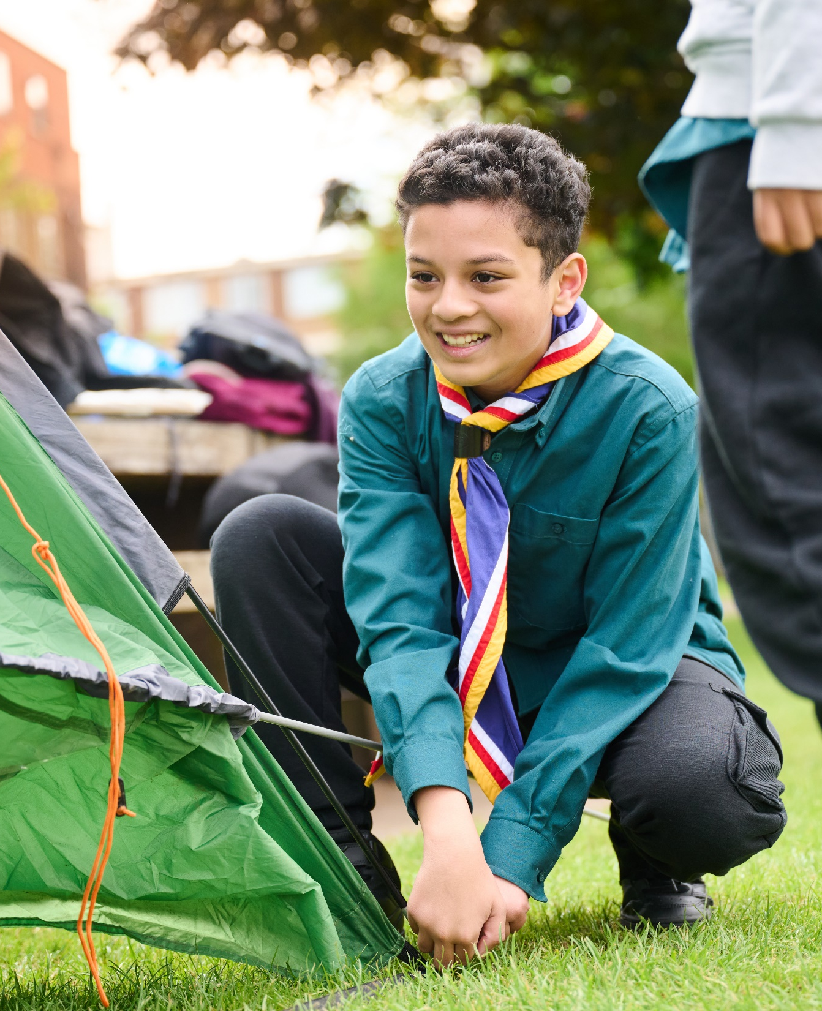
The Young Leader Scheme
Who to contact
If you have any questions, please contact the following people who will be able to help you.
Enter details of County/District contacts here

Slide 16
Thank you
Young Leaders’ Scheme
Scouts.org.uk
#SkillsForLife

