Slide 1
Do more.
Be more.
Young Leaders’ Scheme
Scouts.org.uk
#SkillsForLife
Notes:
If you need to change the background please follow these instructions:
1. On your Windows tablet, tap the Design tab.
2. On your Windows phone, open the slide for editing (either by double-tapping it or by tapping it and then tapping Edit). Tap More at the bottom of your screen, tap Home, and then tap Design.
3. Tap Format Background.
4. You will see the background colours divided into Theme Colours and Standard Colours. Theme colours coordinate with the theme you selected previously. You can select a solid colour or colour gradient.

Slide 2
Explorer Scout Young Leader Training
Module C – That’s the way to do it

Slide 3
Do more. Be more
Welcome
By the end of this session you will:
Understand and be able to talk about how young people learn effectively
Demonstrate an ability to pass on skills to younger people
Understand and talk about different learning styles
Have confidence in using different training techniques
Do more.
Be more.
Young Leaders’ Scheme

Slide 4
Getting to know you...
Notes:
Icebreaker: 5- 10 mins
Key points:
Participants will be working together during the session so it's a good idea to break the ice and get to know each other first.
Activity option 1 - Speed dating:
Everyone walks around the room, finds someone they don’t know and talk for 1 minute
Ask questions: Who got you into Scouts? When did you join Scouts? What key skill do you bring to your Scout team? what they’d like to learn from workshop,
After two minutes, blow a whistle or shout and they find a new partner
Presenters can come up with other questions if they can think of better ones!
Or alternatively depending on amount or type of participants
Activity option 2 – Group discussion
Participants to discuss above questions (from option 1) within their table groups

Slide 5
Ways to teach skills…

Slide 6
Learning Styles
Young people learn in different ways, some need: need:
Words or verbal instructions (auditory)
Pictures they can copy (visual)
A person or video to show them what to do between the pictures (combined)
Practical examples & ‘doing’ (kinaesthetic)

Slide 7
Learning techniques
Different learning styles also suit different situations
Which you use depends on:
The activity
The size of your group & they are reacting to you
What equipment you have or are using
They each have advantages and disadvantages

Slide 8
Task 1: The observer, the runner, the builder
Notes:
Task: The observer, the runner, the builder
(suitable for groups of at least three, approx. 20 minutes)
Split the group into teams of three. In each team, you’ll be assigning different roles. One person in the team should play the role of the ‘observer’. They will be given an object such as a drawing, or a model built from Lego. Another person should play the role of the ‘builder’ or ‘artist’. They have to recreate what the observer is looking at, and shouldn’t be able to see the object at all. The third and final person should play the role of the ‘runner’, who can alternate between the two.
The observer can only give verbal descriptions of their object to the runner. They should not be able to see the object.
The runner must repeat the description to the builder or artist. Again, the runner should not be able to see what they begin to build or draw. The builder cannot ask questions for clarification.
When the runner has finished relaying information and the builder has finished recreating the object, the observer should reveal the object they were describing. The builder or artist should then reveal their recreation.
Regroup to discuss the results of the game. What was difficult about the task? Was it challenging to give a verbal description of a physical object or drawing? What about passing that description on to another person? How about recreating something with only verbal instructions to go on?

Slide 9
Task 2: I do, we do, you do
Notes:
Task: I do, we do, you do
(suitable for groups of all sizes, approx. 25 minutes)
Give each Explorer Scout Young Leader a strawberry lace, and show them how to tie a knot with it.
Next, ask the Explorer Scout Young Leaders to fasten their own knots, instead of just observing you. They should all do this at the same time, creating the knot together. Finally, they should attempt to fasten the knot on their own.
This activity teaches the method of ‘I do, we do, and you do’. Once you have tried all methods, regroup and discuss the points below.
All methods described have both advantages and disadvantages
talking something through gets a message across to lots of people at once, but often misses out on detail
using a diagram or paper copy ensures that everyone gets the same message
demonstrating a skill or technique has visual impact, but you can only use this technique in small groups
demonstrating with material has additional visual impact
in terms of learning, demonstrating something by doing has more effect than merely seeing or listening to something
in general, younger members respond better to doing something simple with coloured bits and pieces
as members get older, written and printed material can be useful
talking to groups has its limitations with any age group, but can be essential in describing the rules of games (as long as they are simple)
small groups lend themselves to demonstrations and tend to respond well to a hands-on approach to learning
larger groups require visual aids that everyone can see, such as slides, Over Head Projectors or PowerPoint presentations, along with a simple and effective verbal message
leadership is easier to do effectively in a small group, especially if everyone is involved in doing things themselves and taking an active role
the larger the group, the more difficult teaching becomes, as boredom and disinterest become issues
using directed questions could be useful, but remember not to pick on any one member all the time
if boredom and disinterest are becoming a problem, maybe you need to rethink the method you're using to get your message across (How can you bounce back? Is there a different way you could approach things?)
Scout Young Leaders using the different colours of the different sweets. Explorer Scout Young Leaders
Top tip: teaching sign language instead of knots can be another good way to cover this method. Alternatively, you could use Smarties instead of strawberry laces, by demonstrating a pattern to the Explorer Scout Young Leaders could attempt to create the pattern at the same time as you, and then attempt to do it themselves from memory. The message remains the same.

Slide 10
Module C
Active learning strategies
There are several benefits to employing active learning strategies in your session that aid the development of young people in a variety of age groups:
Create lifelong learners
Provide students with greater control over their learning
Encourage students to stay focused on their learning
Improve a student’s enthusiasm for their studies
Make a topic more intellectually exciting
Allow students to participate at a higher level of academic discussion
Provide unparalleled support and a more rounded education
Prepare students of any age for future employment
Improve collaboration

Slide 11
Final reflections….
Notes:
Task:
Ask each Explorer Scout Young Leader to reflect and answer the following questions on their own before sharing as a group:
What is one thing I am going to take away from today's session which I can implement into my section?
What is one way I like to learn that might help young people?
Is there anything you want to learn more about following today's session?

Slide 12
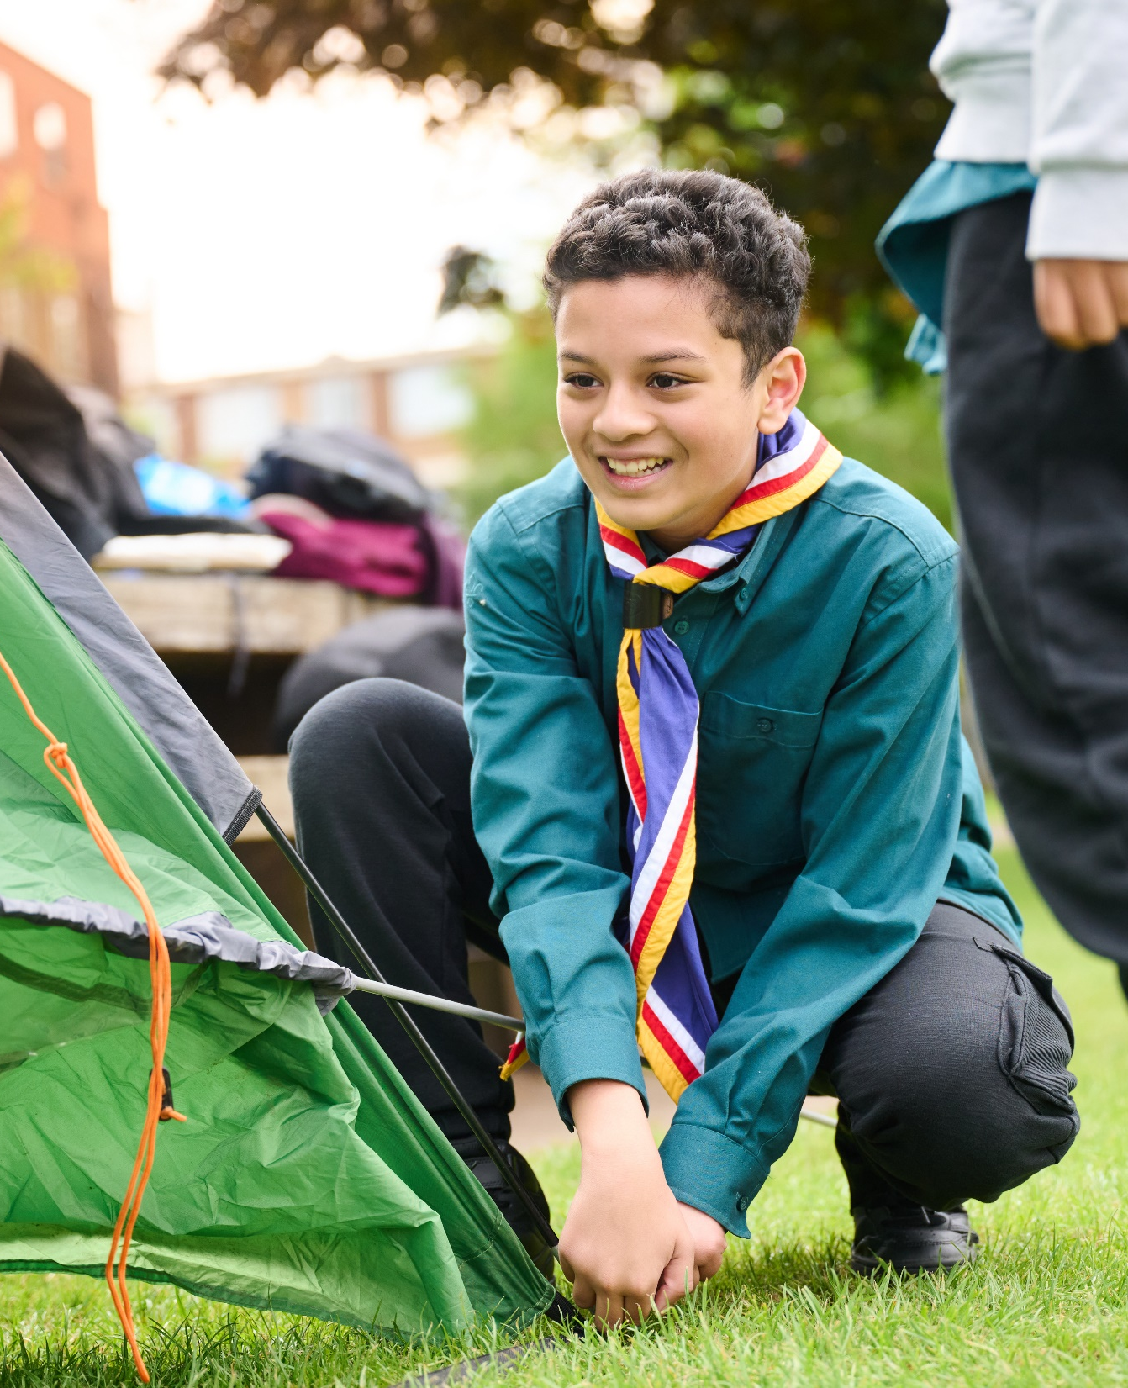
The Young Leader Scheme
Who to contact
If you have any questions, please contact the following people who will be able to help you.
Enter details of County/District contacts here

Slide 13
Thank you
Young Leaders’ Scheme
Scouts.org.uk
#SkillsForLife

