Slide 1
Notes:
As children are walking into the hall have slide 1 on display – alternatively, use the animate fleur de lis MP4, available for download from the brand centre.
Introduce yourself
Move onto slide 2 when ready to start……

Slide 2
Squirrels
4-6 yrs
Notes:
If you are aged 4 or 5 you could become a Squirrel Scout. Squirrels do lots of fun games like “duck, duck, goose” and activities including finding out about space, going for hikes or even visiting a fire station! All the sessions are based around stories, because we love to read. Squirrels meet every week, often bringing along a grown up to join the fun. You can do almost everything that our older sections do…. Including a sleep over in your hut.

Slide 3
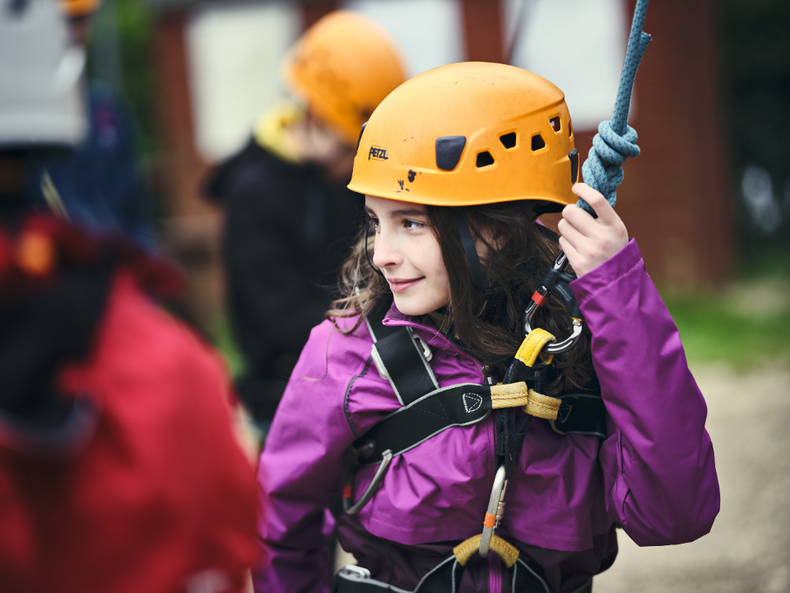
Beavers
6 -8 yrs
Notes:
If you are 6 or 7, you could be a Beaver Scout. You get to have loads of fun doing activities and games and making new friends. Beavers usually meet in a hall, but they may meet outdoors and they play games like dodgeball or relay races. Beavers often make things, and do loads of fun activities like cooking, reading, science and learning about the world. They also get to do things such as have sleepovers, build dens and search for bugs. Beavers is all about fun and friends.

Slide 4
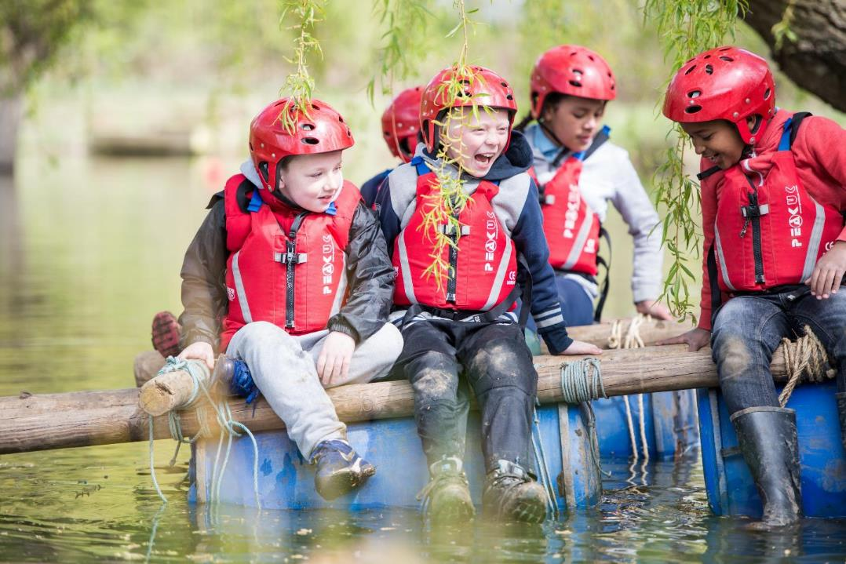
Cubs 8 -10 yrs
Notes:
If you are 8, 9 or 10, you could be a cub. Once you are a cub, you might get to try out even more exciting activities, like these cubs, who have built a raft! Cubs still play lots of games, and they might do challenges in teams or individually. Cubs usually go to camp in tents each year, and love collecting wood to build a fire. Cubs might do activities like hikes or sports day, cooking or chess. Cubs are great friends to each other and other people.

Slide 5
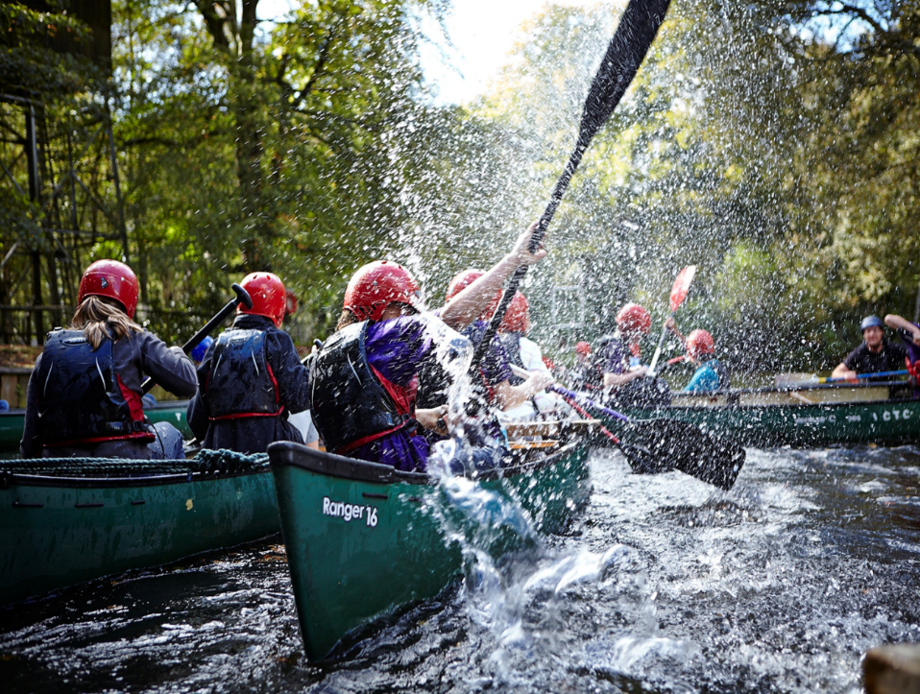
Scouts
10 -14 yrs
Notes:
If you are over 10, then Scouts is for you. Scouts work as a team to achieve some amazing things. It might be the tallest tower out of paper cups or a race down a river in a canoe. Scouts go camping too, and love making fires to cook their food. They might also learn about astronomy or electronics and they might go hiking up a mountain or even in the dark.

Slide 6
Is Scouting just for Boys?
Subhead goes here
Notes:
Squirrels, Beavers, Cubs and Scouts are all for boys And girls. It doesn’t matter what you enjoy, there will be something for you. Whether you like sports or photography, climbing or creating, there will be something for you.

Slide 7
Notes:
Well we earn these things. Badges. We take part in lots of different activities to earn different badges and awards (for example the highest award a Scout can earn is the Chief Scout Gold award).
BUT more importantly we have fun, while learning important life skills along the way.
We have over 200 outdoor activities to choose from…
What activities do we do? Ideas?

Slide 8
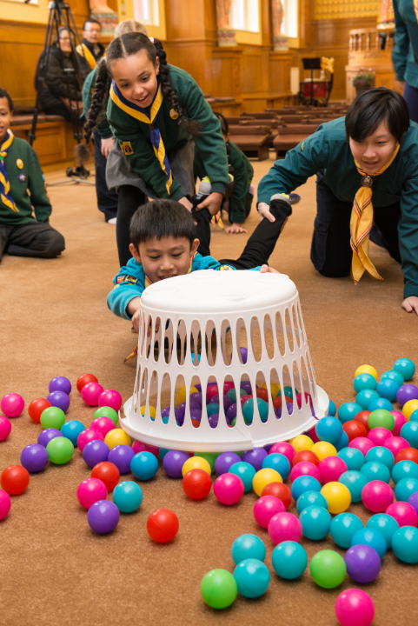
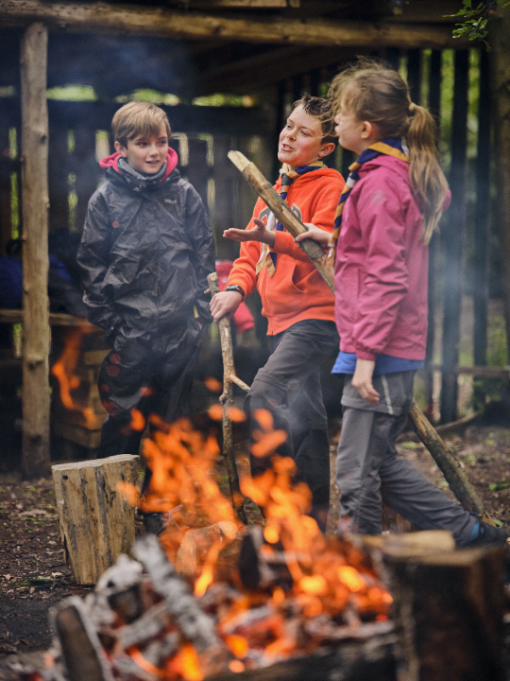
Notes:
Some of our activities that you can take part in?
Firelighting
Hungry Hippos

Slide 9
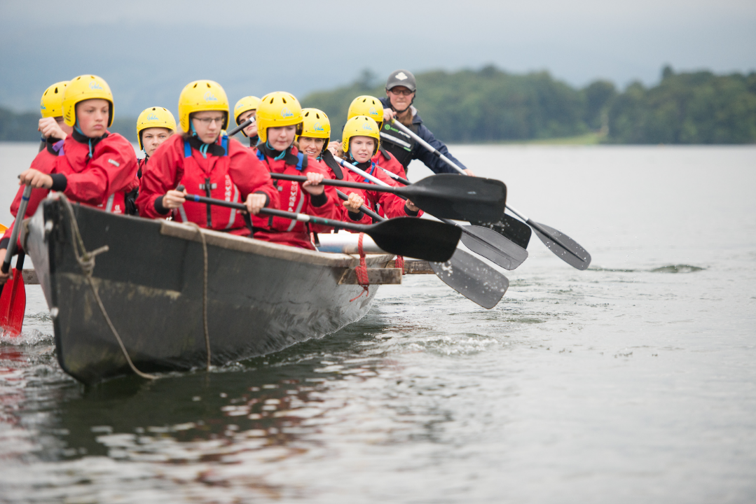
Notes:
Paddling

Slide 10
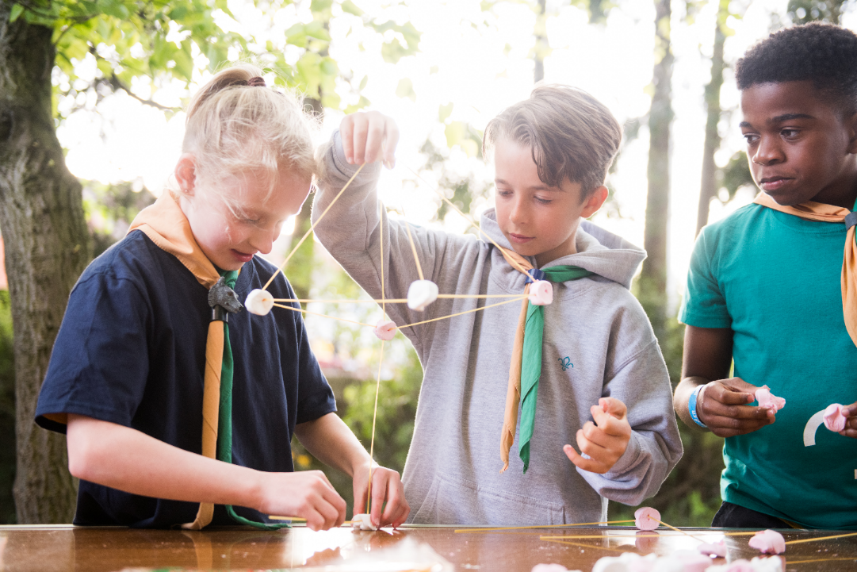
Notes:
Pioneering / Making structures

Slide 11
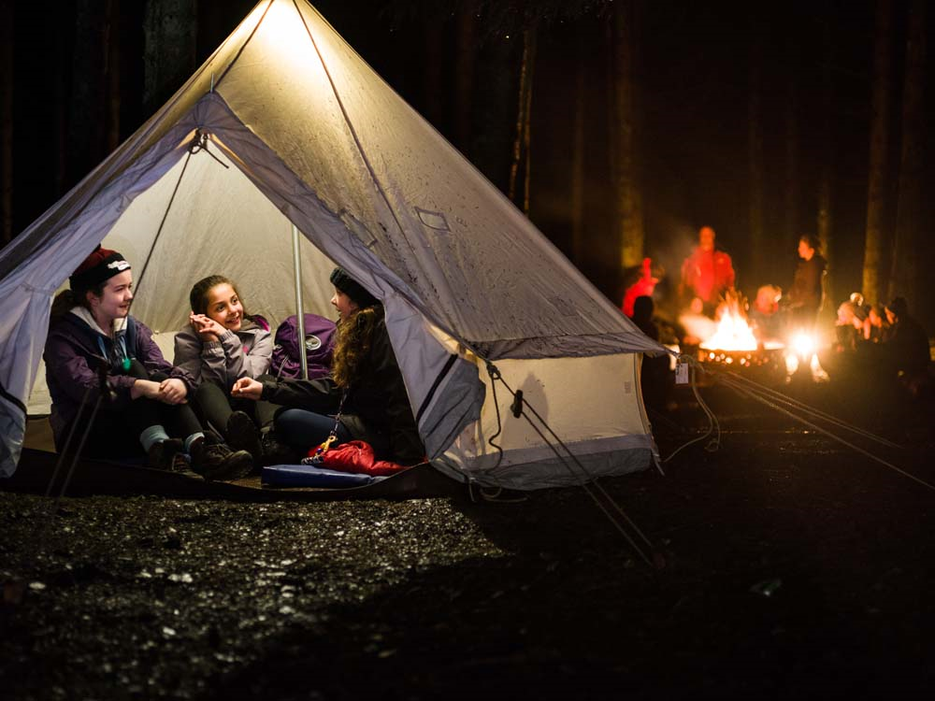
Notes:
Camping

Slide 12
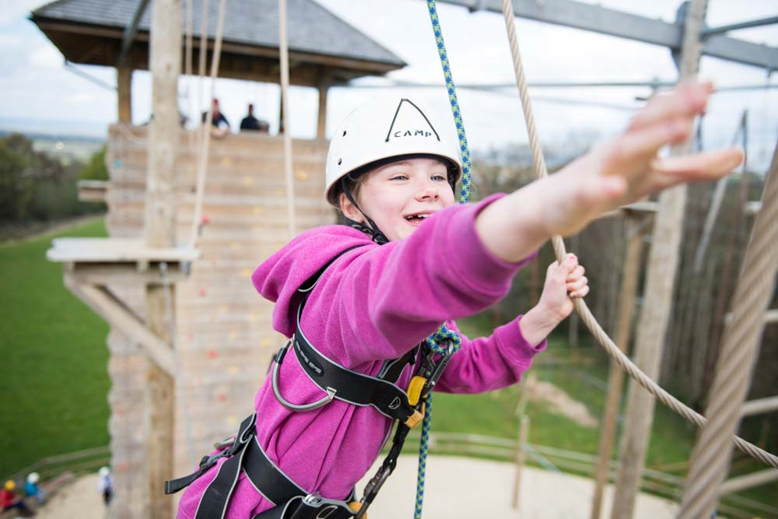
Notes:
High Ropes

Slide 13
What activities do we do?
https://www.youtube.com/watch?v=cfEQkVEk_XU
Notes:
How many activities can you spot in this video?
Show video- scout adventures fundays 2017
Can use a different video from the brand centre, depending on the time you have during the assembly

Slide 14
Give it a go……….!
Date
Time
Venue
Notes:
Notice of taster event

Slide 15
(Insert Group Name)

