Slide 1
Notes:
As children are walking into the hall have slide 1 on display
Move onto slide 2 when ready to start……

Slide 2
Welcome
Notes:
Introduce yourself
Thank them for allowing you to spend some time during their assembly

Slide 3
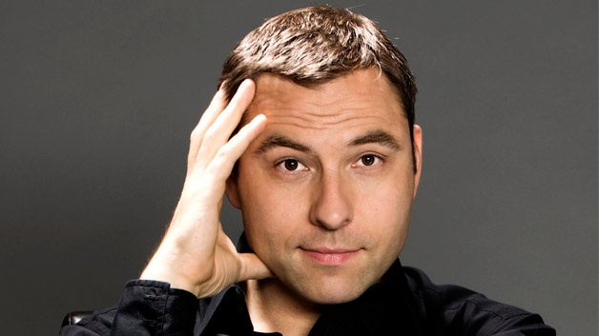
Notes:
David Walliams
is an English actor, comedian, writer, and television personality. He is best known for his partnership with Matt Lucas on the BBC One sketch comedy shows Little Britain and Come Fly With Me. Since 2012, he has been a judge on the ITV talent show Britain's Got Talent. He is also a writer of children's books, having sold more than 25 million copies worldwide.

Slide 4
Notes:
Richard Hammond
is an English presenter, writer, and journalist, best known for co-hosting the BBC Two car programme Top Gear from 2002 until 2015 with Jeremy Clarkson and James May.

Slide 5
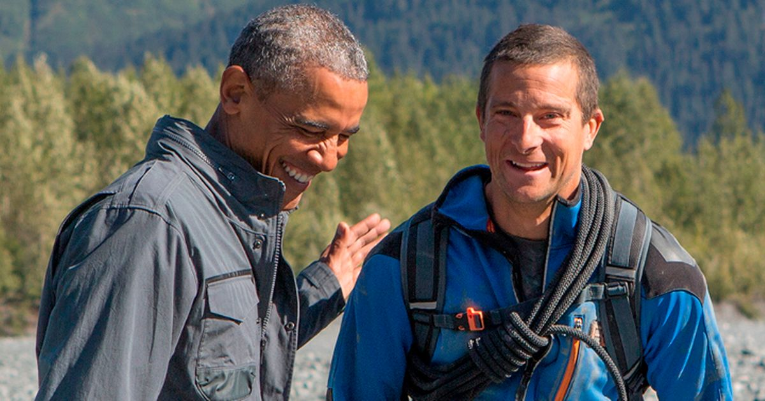
Notes:
Barack Obama and Bear Grylls
Barack Hussein Obama II (/bəˈrɑːk huːˈseɪn oʊˈbɑːmə/ (listen);^{[1]} born August 4, 1961) is an American attorney and politician who served as the 44th president of the United States from 2009 to 2017.
Bear Grylls, is a British former SAS serviceman, survival instructor, and honorary lieutenant-colonel, and, outside his military career, an adventurer, writer, television presenter and businessman.

Slide 6
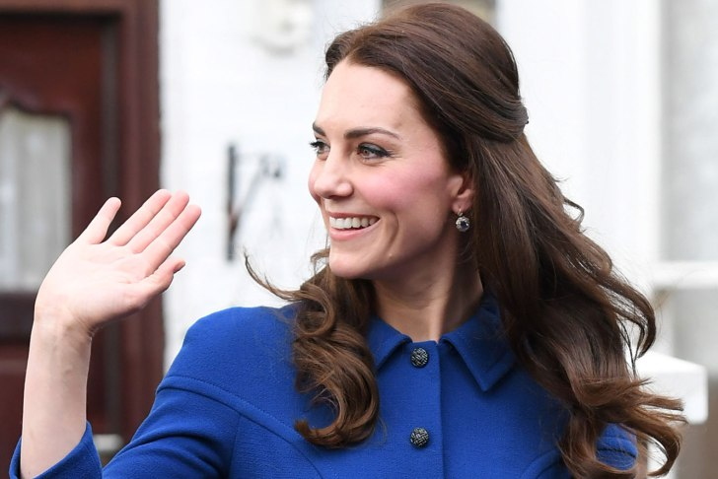
Notes:
Duchess of Cambridge – Catherine, Duchess of Cambridge, GCVO (born Catherine Elizabeth Middleton; 9 January 1982^{[1]}), is a member of the British royal family. Her husband, Prince William, Duke of Cambridge, is expected to become king of the United Kingdom and 15 other Commonwealth realms, making Catherine a likely future queen consort.^{[2]}

Slide 7
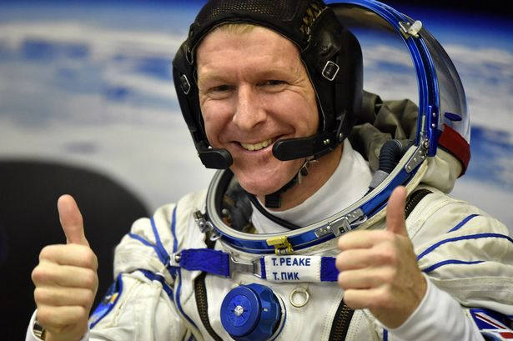
Notes:
Tim Peake is a is a British Army Air Corps officer, European Space Agency astronaut^{[3]} and a former International Space Station (ISS) crew member.

Slide 8
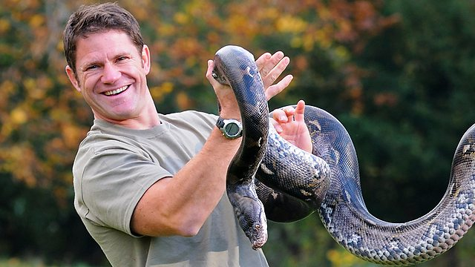
Notes:
Steve Blackshall - one of TV's best-known wildlife presenters, naturalists, writers, public speakers and adventurers.

Slide 9
What do they all have
in common?
Notes:
They have all been Scouts

Slide 10
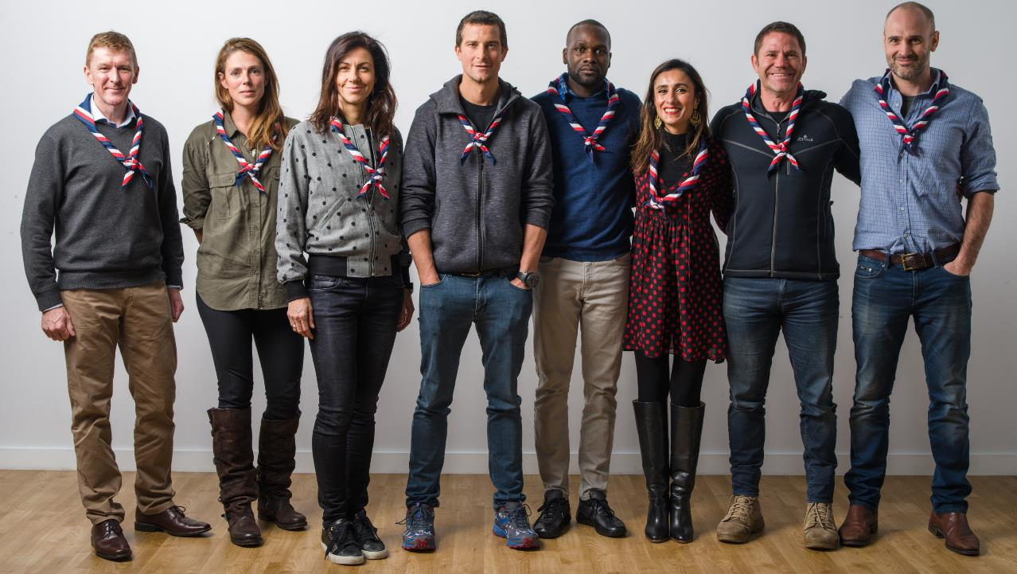
Notes:
Our Scout Ambassadors
Ellie Simmonds OBE, Anita Rani, Tim Peake, Steve Backshall, Helen Glover MBE, Megan Hine, Julia Bradbury, Ed Stafford, Chris Evans, Dwayne Fields, Warwick Davis

Slide 11
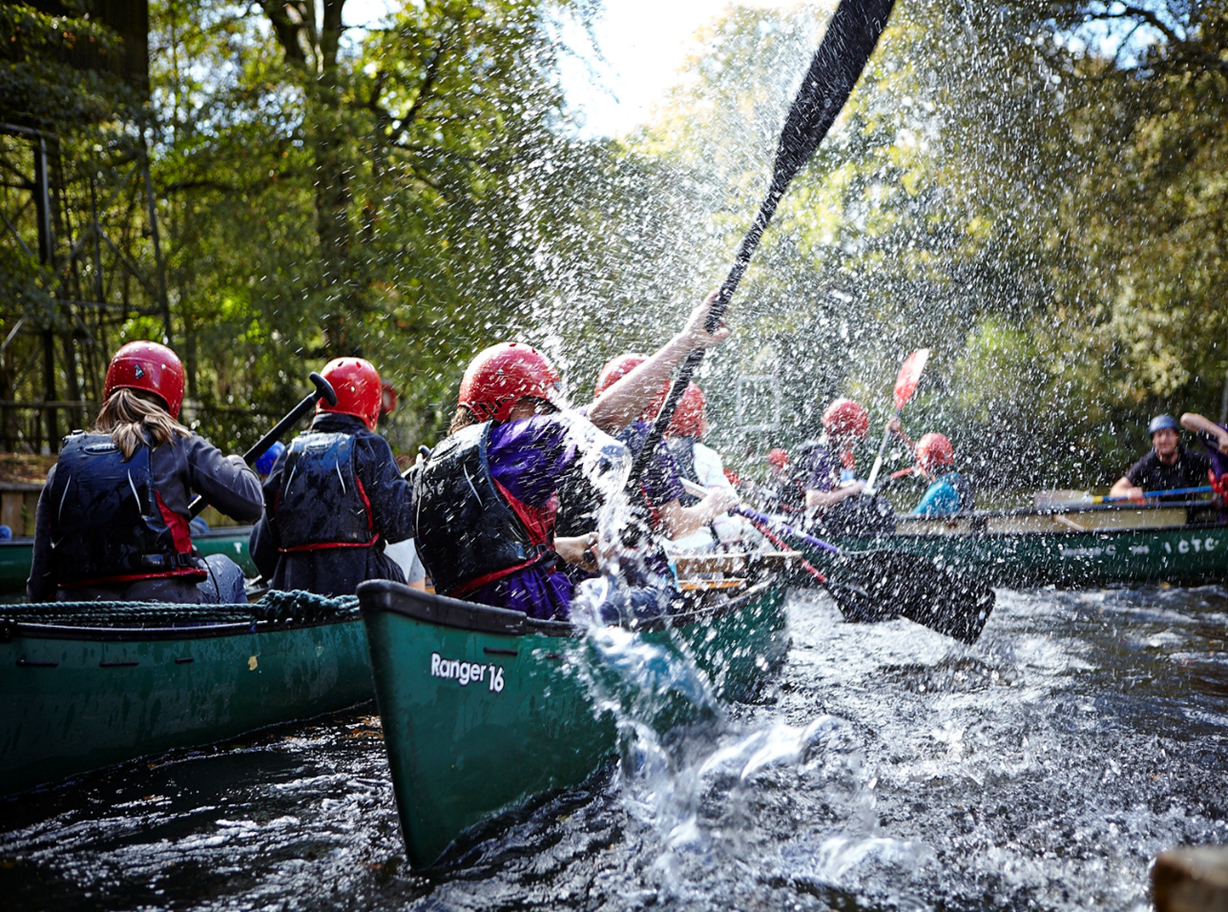
Scouts
10 -14 yrs.
Notes:
Scouts aims to build and develop young people’s confidence, sense of adventure and outdoor skills, as well as encouraging them to explore their beliefs and attitudes and be creative. It offers them the independence to put these skills into practice at camps and even on international trips. Scouts are encouraged to work together and take the lead on all sorts of projects, from community based work to planning games and activities for their meetings. The Scout Troop is the third section in the Scout Group, above Beavers and Cubs. The Scout Section is for young people aged between 10½ and 14 years. There is core flexibility in the age range: young people can join from age 10, and can move to Explorers between age 13½ and 14½. It may sometimes be appropriate to extend this flexibility for young people with additional needs. For further information, see our guidance on age range flexibility.

Slide 12
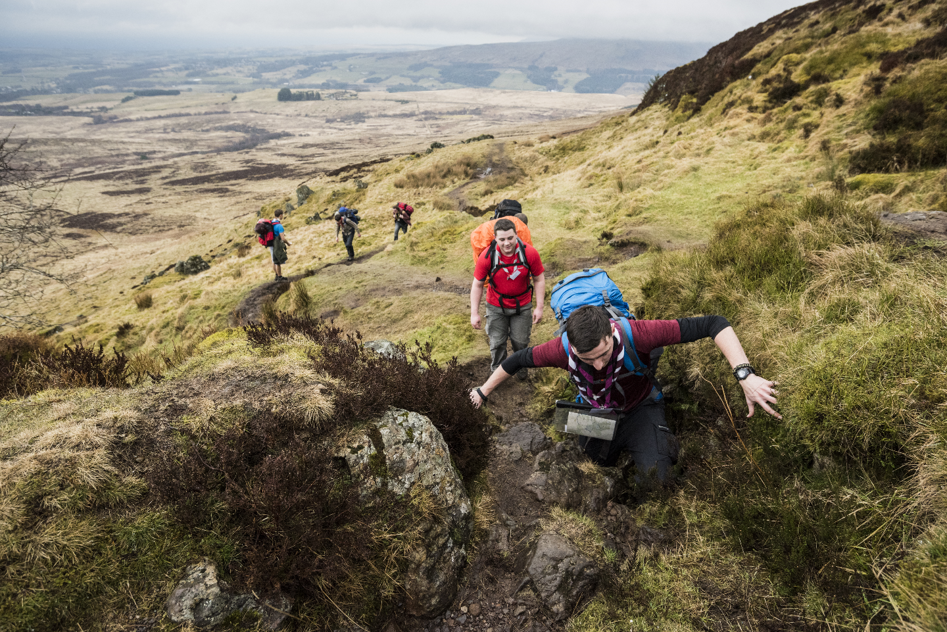
Explorers 14-18yrs
Notes:
With the support, direction and guidance of Unit leaders, Explorer Scouts are encouraged to lead themselves, design their own programme and work towards the top awards that Scouting offers. With exciting prospects like being a part of camps and expeditions both home and abroad; adventurous activities such as mountaineering, parascending and off shore sailing; Explorers offers fun and adventure for all. Explorers also have the opportunity to be a part of The Explorer Scout Young Leaders’ Scheme which develops their leadership skills and sense of responsibility, by helping to run meetings for younger sections.
Explorer Units are the fourth Section of the Scouting family after Beavers, Cubs and Scouts. Explorer Scouts are young people aged between 14 and 18 years old. There is flexibility in the age range: young people can join from age 13½ but cannot move to Scout Network until 18. Young people must have left the Explorer Scout section before the date of their 18th birthday. For further information, see our guidance on age range flexibility.

Slide 13
Myth Busting
Notes:
Ask children to raise their hands for Yes or No

Slide 14
Scouting is just for Boys?
Subhead goes here
Notes:
Boys and Girls

Slide 15
All Scouts do is camp, hike and tie knots?
Subhead goes here
Notes:
Lots of activities and badges
200 different activities
he Scouting Programme provides a structure of badges and awards, which are progressive through the sections, and based on a number of objectives. The objectives are based on Scouting’s Purpose to ‘actively engage and support young people in their personal development, empowering them to make a positive contribution to society’. The Scouting Programme for all five sections is based around three main themes: outdoor and adventure, world and skills. This programme of activities is planned by the leadership team in partnership with young people, and should incorporates elements from each theme, to offer young people the most interesting and diverse experience. There is flexibility within Scouting which means that all young people, regardless of their abilities, can enjoy and achieve. The Programme should be flexible and have room to adapt and accommodate the needs of the individuals in the section, with the focus being on personal development. For more information, see our flexibility statement.

Slide 16
We are called Boy Scouts?
Subhead goes here
Notes:
In correct
The Scouts

Slide 17
Scouts wear big hats and baggy shorts?
Subhead goes here
Notes:
Only if they want to

Slide 18
So what are Skills for Life?
Skills for life video
Notes:
Show video

Slide 19
What activities do we do?
https://youtu.be/-MEm8POvalA
Notes:
Show Video

Slide 20
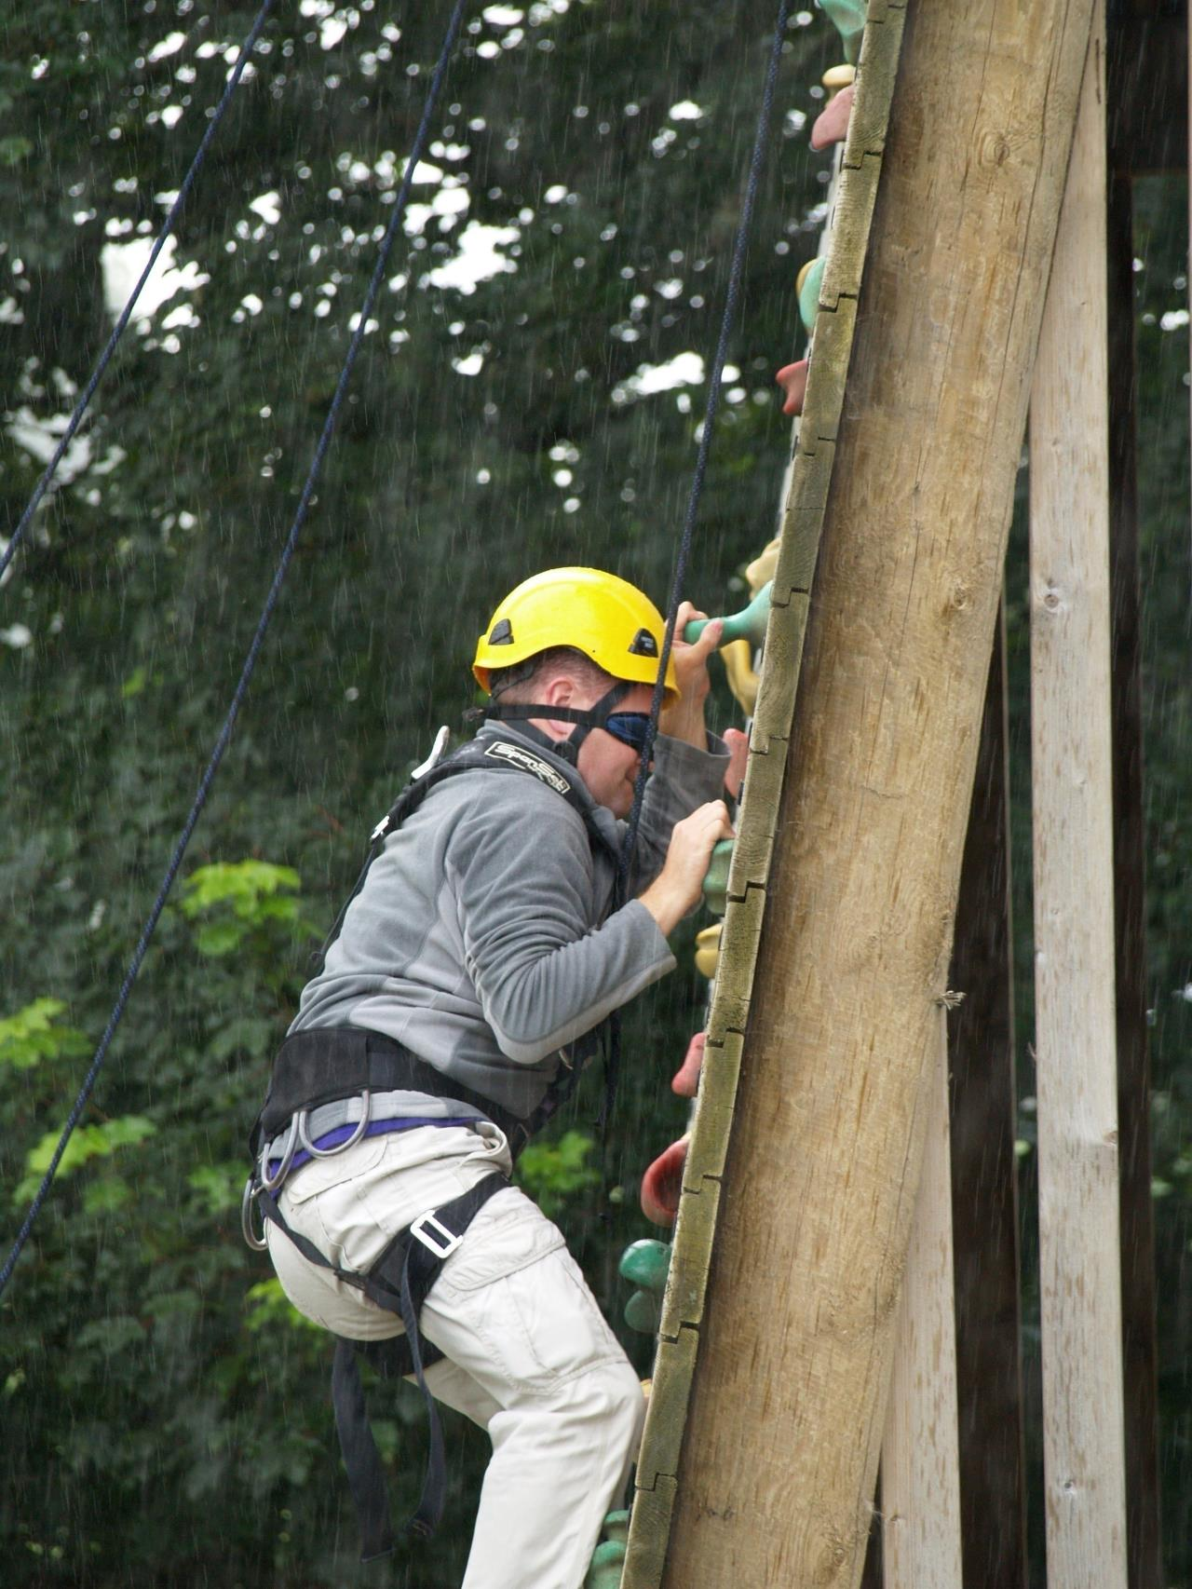
Notes:
Climbing

Slide 21
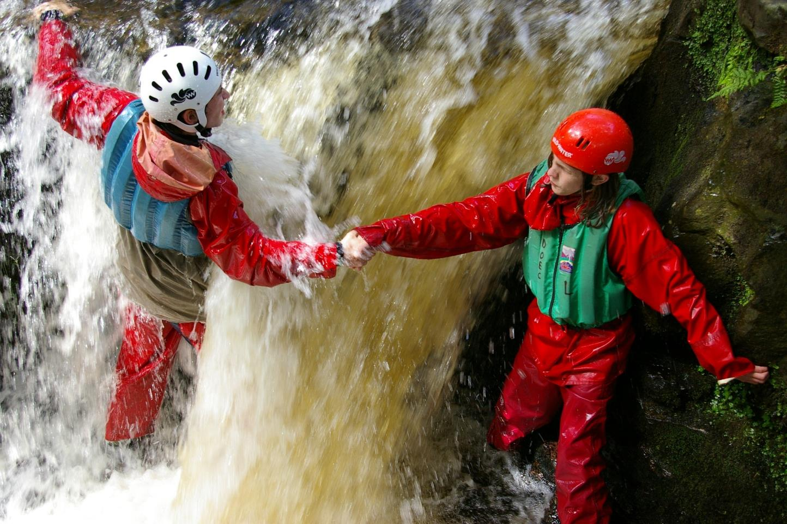
Notes:
Coasteering

Slide 22
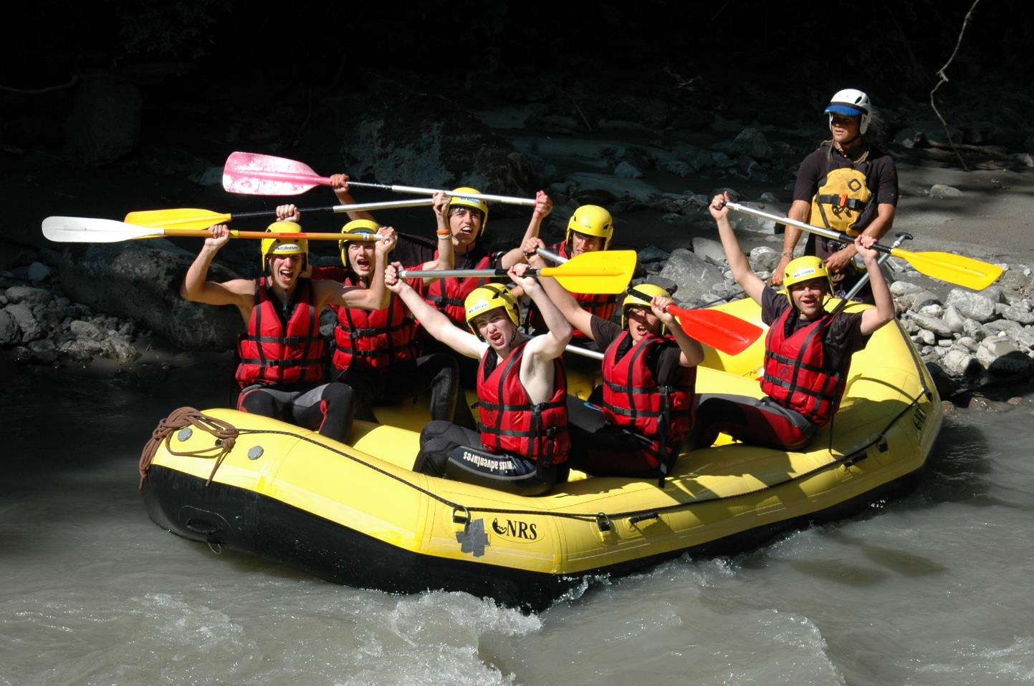
Notes:
White water Rafting

Slide 23
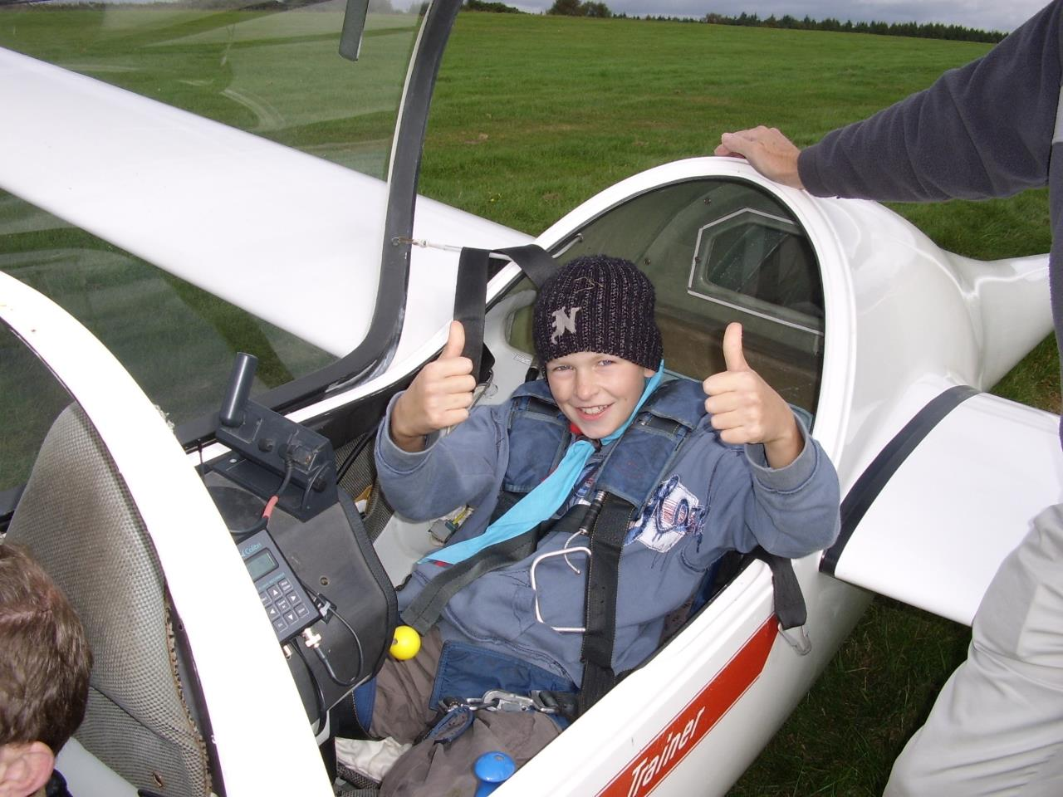
Notes:
Gliding

Slide 24
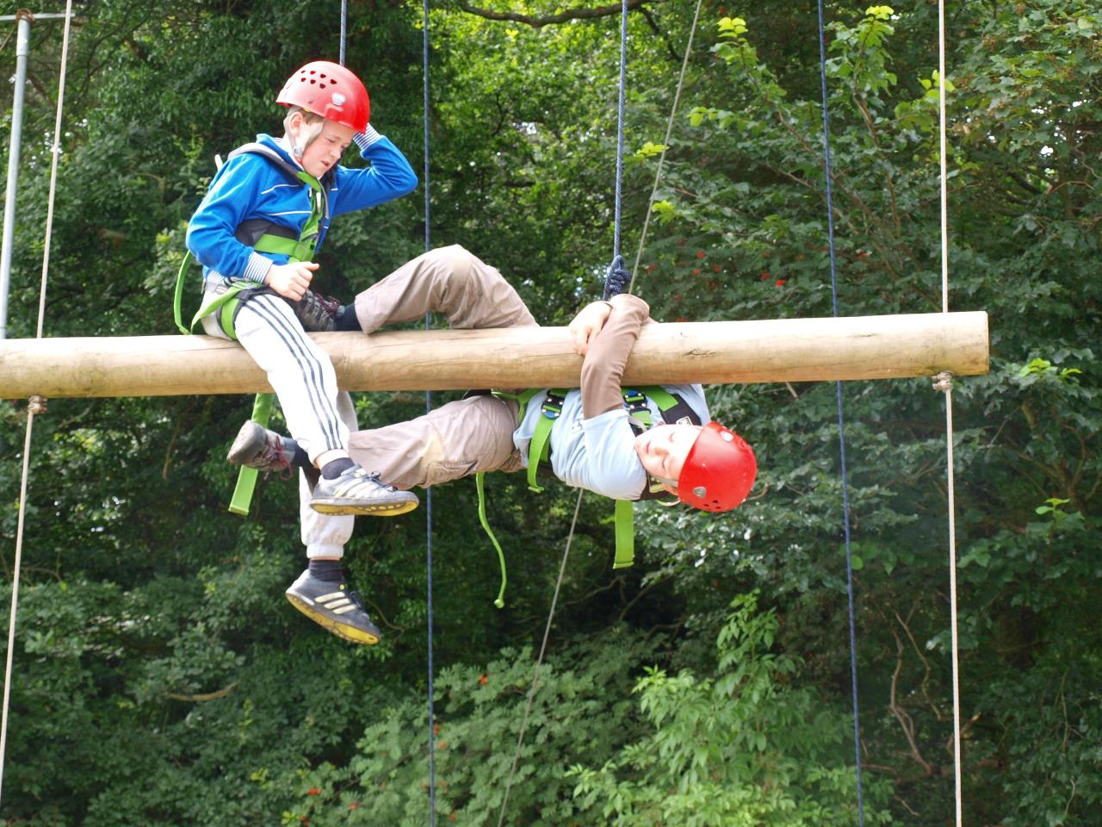
Notes:
High Ropes

Slide 25
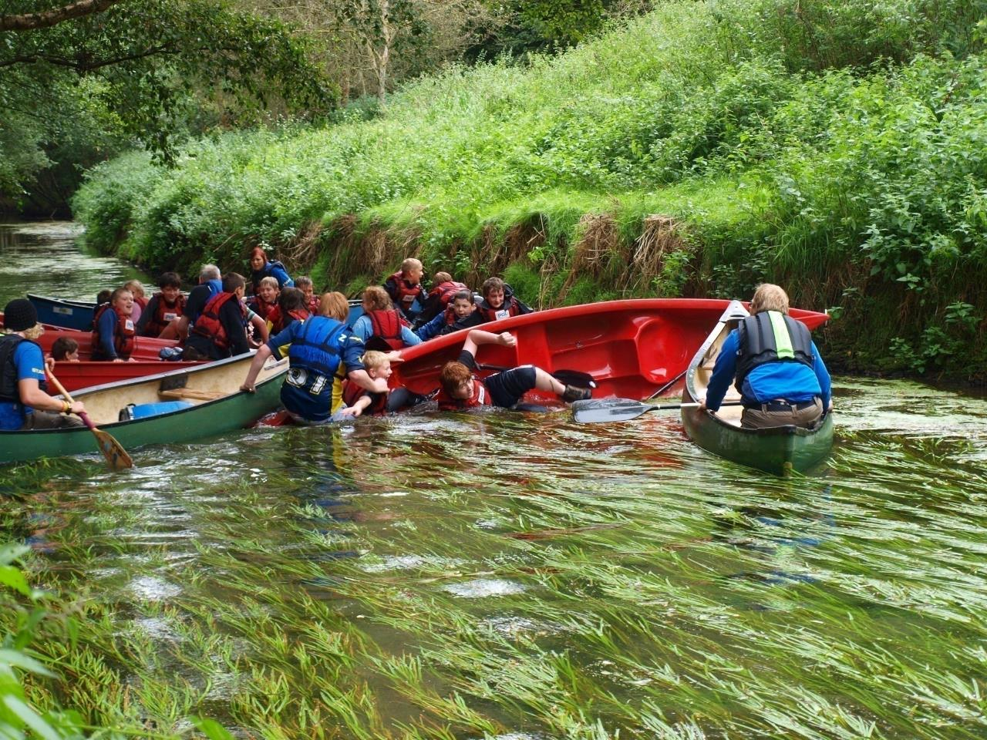
Notes:
Canoeing

Slide 26
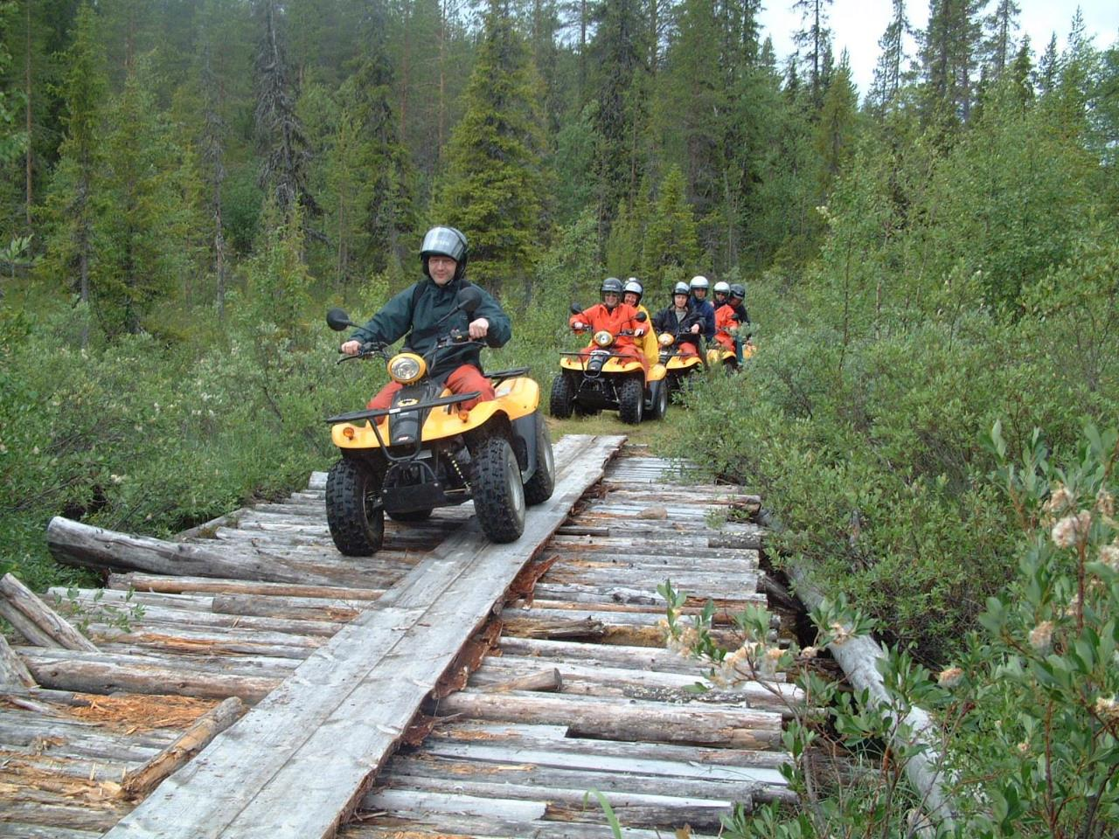
Notes:
Quad biking

Slide 27
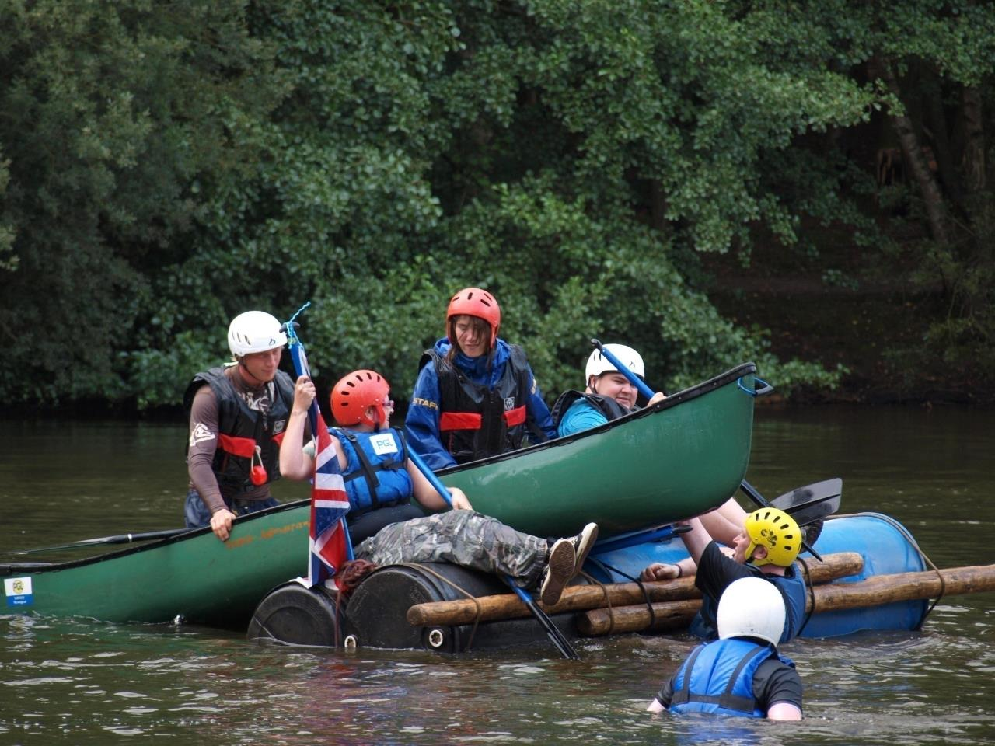
Notes:
Raft Building

Slide 28
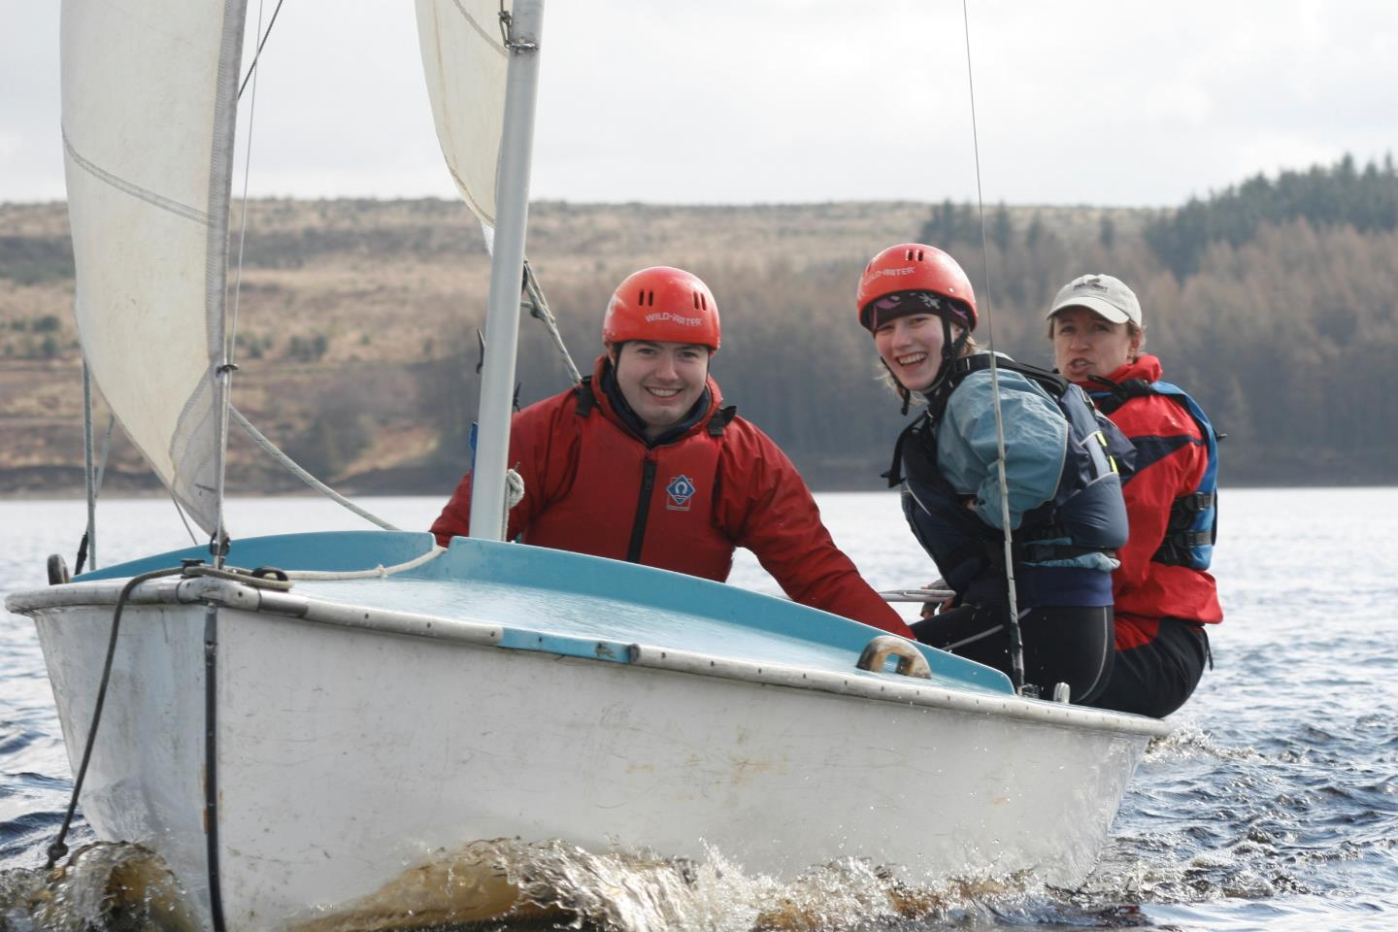
Notes:
Sailing

Slide 29
Give it a go……….!
Date
Time
Venue
Notes:
Talk about date and time of taster event

Slide 30
(Insert Group Name)

