Slide 1
Do more.
Be more.
Young Leaders’ Scheme
Scouts.org.uk
#SkillsForLife
Notes:
If you need to change the background please follow these intructions:
1. On your Windows tablet, tap the Design tab.
2. On your Windows phone, open the slide for editing (either by double-tapping it or by tapping it and then tapping Edit). Tap More at the bottom of your screen, tap Home, and then tap Design.
3. Tap Format Background.
4. You will see the background colours divided into Theme Colours and Standard Colours. Theme colours coordinate with the theme you selected previously. You can select a solid colour or colour gradient.

Slide 2
Explorer Scout Young Leader Training
Module A – Preparing for Take-off

Slide 3
Do more. Be more
Welcome
In this session, we are going to look at:
What is a young leader?
What to expect as a young leader
What support is available
Keeping everyone safe
Do more.
Be more.
Young Leaders’ Scheme

Slide 4
Getting to know you...
Notes:
Icebreaker: 5- 10 mins
Key points:
Participants will be working together during the session so it's a good idea to break the ice and get to know each other first.
Activity option 1 - Speed dating:
Everyone walks around the room, finds someone they don’t know and talk for 1 minute
Ask questions: Who got you into Scouts? When did you join Scouts? What key skill do you bring to your Scout team? what they’d like to learn from workshop,
After two minutes, blow a whistle or shout and they find a new partner
Presenters can come up with other questions if they can think of better ones!
Or alternatively depending on amount or type of participants
Activity option 2 – Group discussion
Participants to discuss above questions (from option 1) within their table groups

Slide 5
What is a Young Leader?
Notes:
Pair discussion (or breakout rooms if online) (3 mins)
Participants to come up with 5 words (or phrases) they associate with Young Leaders or what they think being a Young Leader will be like

Slide 6
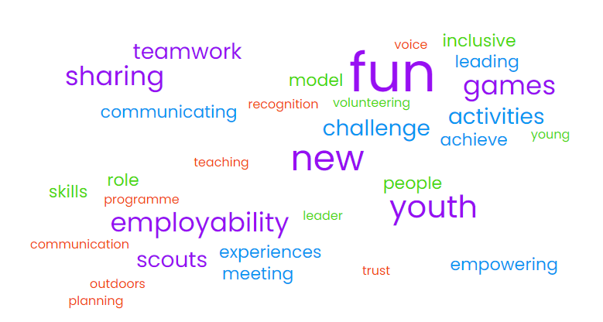
Module A - YLS
Do your words match?
Notes:
Other examples to consider:
Teamwork
planning
communication
Leader
Teaching
Communicating
Empowering
Trust
Sharing
Outdoors
Scouts
Experiences
Meeting
Programme
New experience
People
Youth
Young
Achieve
Activities
Games
Voice
Inclusive
Fun
Volunteering
Role Model
Recognition

Slide 7
Module A - YLS
Young Leaders…
Are Explorer Scouts who help lead Younger People (Scouts, Cubs, Beavers, and Squirrels)
Have the support of their own Leaders, as well as of the Leaders in the section they’re helping
Work towards the Young Leader Award by completing training (‘Modules’) and challenges (‘Missions’) while volunteering
Notes:
Now discuss in more detail what a Young Leader is.
Remember you might have some participants who have not gone through the sections.

Slide 8
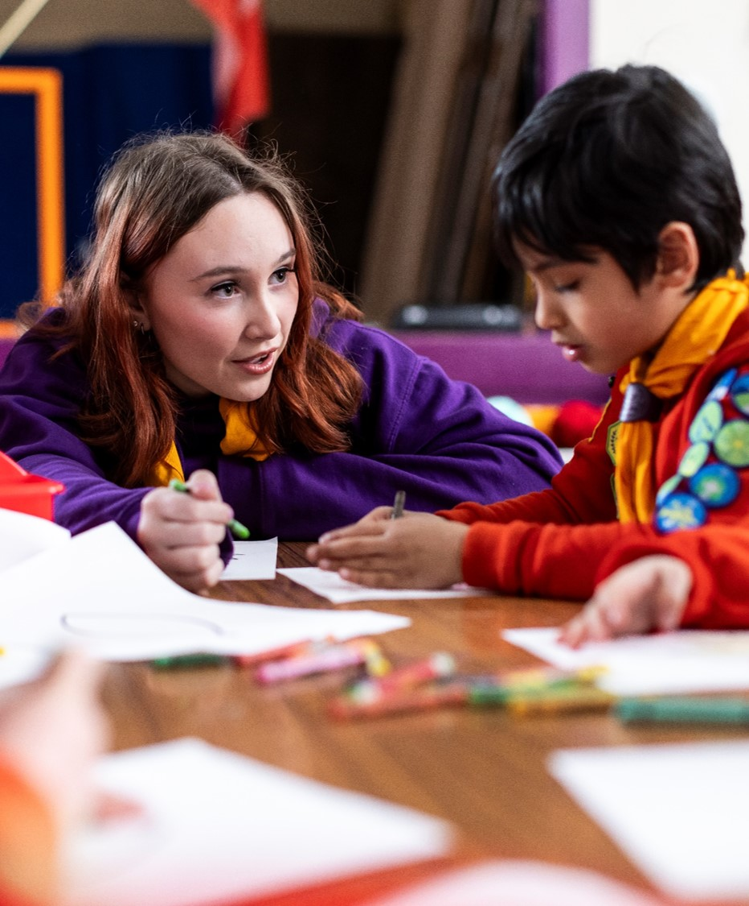
Module A - YLS
What responsibilities do Explorer Scout Young Leaders have?
Notes:
Discussion task: 5 mins
Get Young Leaders to discuss the following questions in pairs/small groups:
What things might you be asked to do as a Young Leader?
What are you looking forward to doing as a Young Leader?
How will the Young Leader role change your dynamic with young people and adult volunteers in the section?

Slide 9
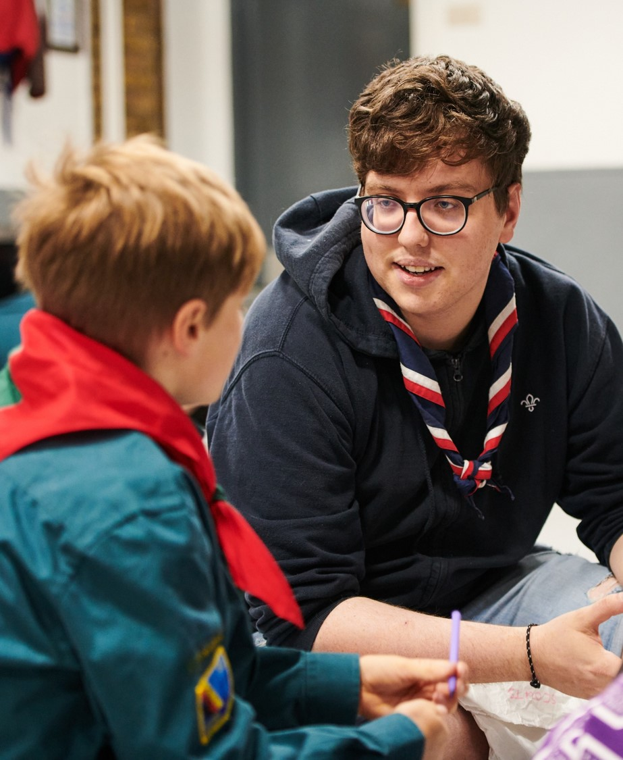
Module A - YLS
What skills can help me as a Young Leader?
Notes:
Task: 5 mins
As a group create a list of all the skills/talents you think will help you as a Young Leader!
Hints:
What do you enjoy doing?
What could you teach others?
What did you learn in Scouts that you could pass on?
Do we want everyone to have the same skills and talents? If not, why not?

Slide 10
Module A - YLS
Who can you turn to for support?
Notes:
Think about who forms your support network? (5-10 mins)
When you are a young leader there might be times where you have questions and you need to know who you can turn to: Who you gonna call?
Activity: Using a ball of string/wool. Throw the ball of string to someone else in the room/circle and say one person you might be able to turn to for support. They then throw to someone else etc. This will create a web for people with lots of examples.
Potential examples: Section leaders, Group Scout Leader, Other young leaders, Young people, Training manager, Explorer Scout leader, teachers, friends, family etc.

Slide 11
Principals of Scouting and POR

Slide 12
Our Fundamentals – Our Purpose
"Scouting exists to actively engage and support young people in their personal development, empowering them to make a positive contribution to society”
Notes:
Fundamentals = a central or primary rule or principle on which something is based.

Slide 13
Our Fundamentals – Our Method
Good quality Scouting takes place when young people and adults…
Live by the Scout values!
Have fun!
Learn from each other!
Try new things!
Share skills!
Notes:
Ask young people if there is anything missing?
Young leaders responses will be based on a variety of experiences and might throw up something you did not expect. Also, please add any extra experiences from your time in Scouting.

Slide 14
Come up with 5 examples where you can live by the Scout values as a young leader:
Integrity… we act with integrity, we are honest, trustworthy and loyal
Respect… we have self-respect and respect for others
Care… we support others and take care of the world in which we live
Belief… we explore our faiths, beliefs and attitudes
Co-operation… we make a positive difference, co-operate with others and make friends
Notes:
Extra task:
Come up with 5 examples where you can live by the Scout values as a young leader:

Slide 15
Your safety, our safety
Notes:
Important to remind Young Leaders that this part is really important, but also that they have nothing to worry about and to ask any questions they have.
Try to give them an opportunity to ask quietly if they do not want to answer in front of the group.

Slide 16
The Rules
Policy, Organisation and Rules (POR)…
Provides support and guidance to help us all run Scouting
Applies to every single person in Scouting
Includes rules on specific activities
You can find it at scouts.org.uk/por

Slide 17
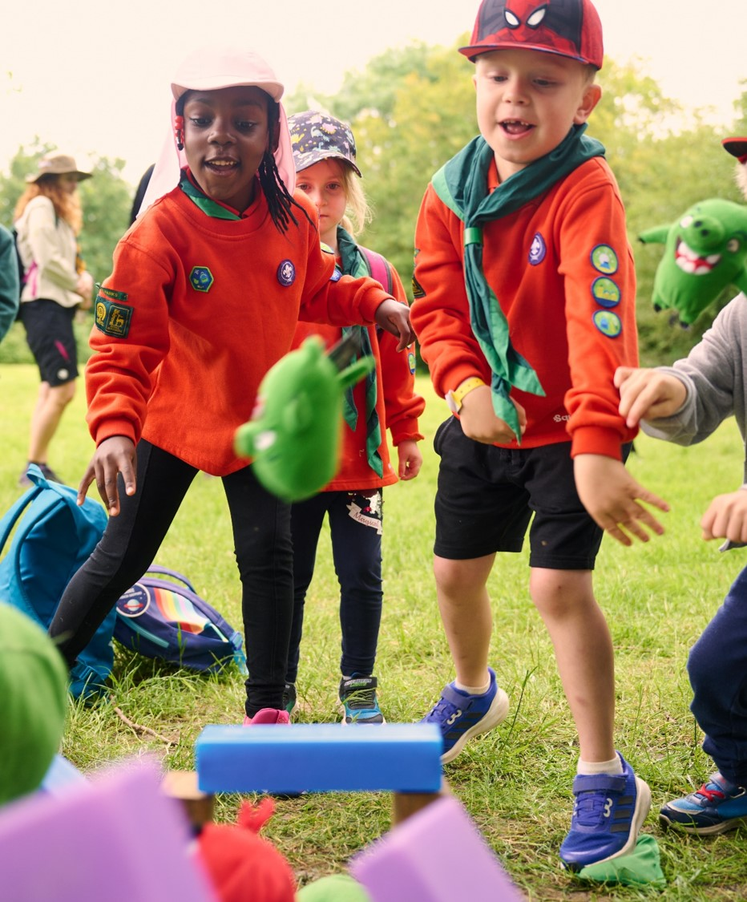
The Rules
Scouts’ Safety Policy…
Adventure should be exciting, but not dangerous
We achieve this by:
Identifying risks, and minimising them as much as possible
Giving clear instructions and training
Not being afraid to stop or change an activity if it becomes too risky

Slide 18
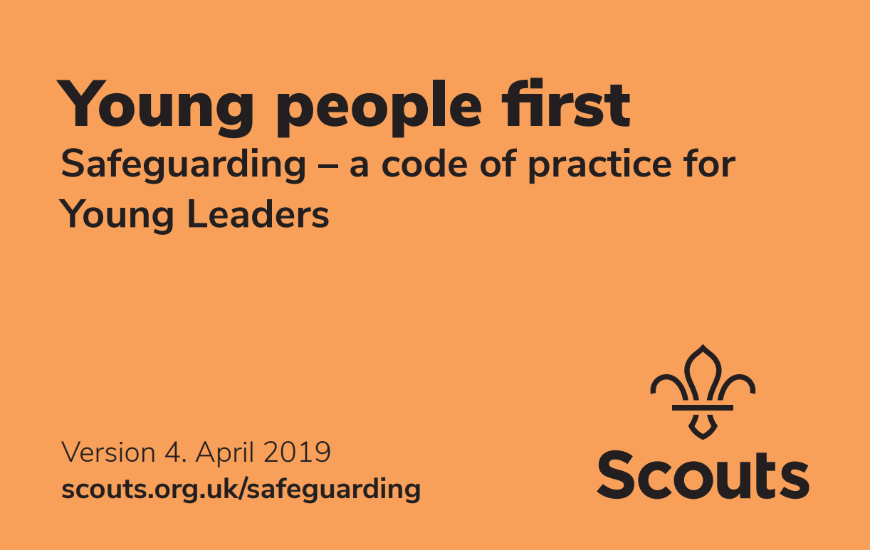
Safeguarding and The Orange Card
Safeguarding is…
Ensuring that we always put the wellbeing of Young People first
Something that all Adult Leaders and Young Leaders are responsible for putting into practice
Covered by the Yellow Card for Adult Leaders, and the Orange Card for Young Leaders
Always following the rules established for ensuring the safety and security of Young People, and rules for reporting incidents

Slide 19
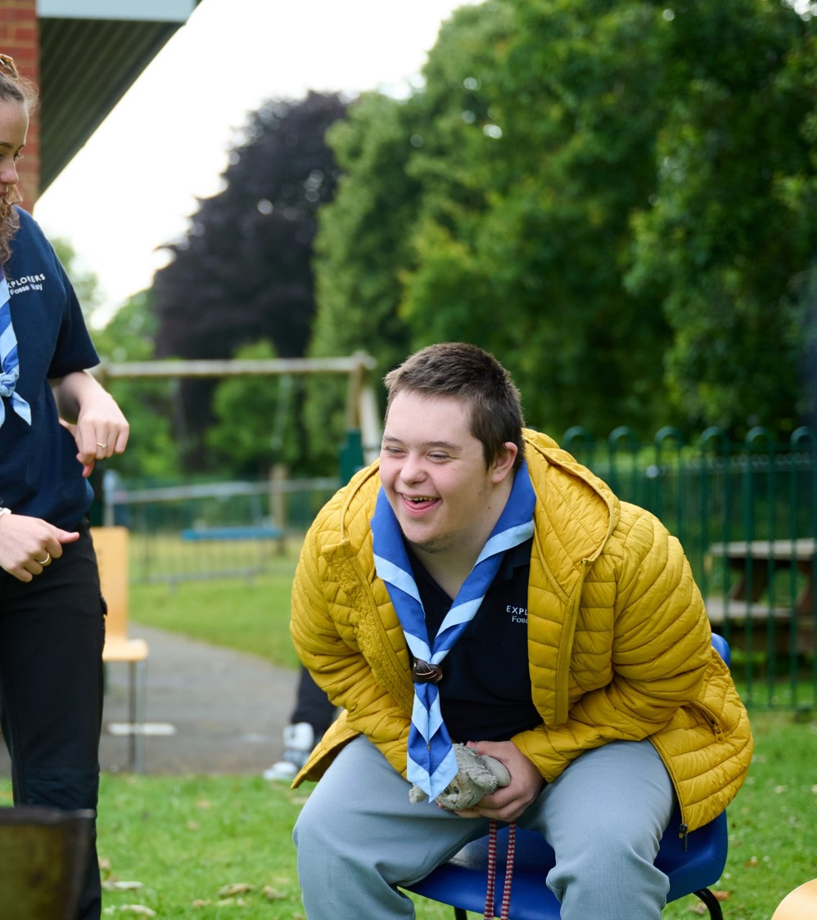
Safeguarding and The Orange Card
Safeguarding includes…
Implementing our Anti-Bullying Policy, to ensure a caring and supportive atmosphere, where bullying in any form is unacceptable
Taking action to deal with bullying when it happens, and allowing Young People to talk about their concerns
Encouraging and inspiring others to feel comfortable and caring enough to point out attitudes or behaviour they don’t like

Slide 20
The Rules
Over to you...
In small group we will give you a scenario which could happen at a section meeting. We want you to decide as a group what you would do next. We have provided some questions to think about
Is everyone safe?
Do you need to deal with the situation immediately, or is it not time sensitive?
Can you deal with the situation on your own? If not, who will you ask to help?
What will you do next?
Notes:
Task: 15 mins
Give a scenario to each small group. Feel free to provide some hints if they are unsure. Ask the groups to pick someone who can explain their scenario and next steps to the whole group at the end.
Try picking a scenario the Young Leaders might not have come across before. Consider what they gave as their skills in an earlier task.
Scenario A: A Beaver Scout has started being aggressive towards others
Scenario B: An older sibling who you don't know has come to collect one of the Cubs at the end of a section meeting
Scenario C: A Scout tells you that they are being excluded by some other young people and they are calling them by a nickname they do not like.
Scenario D: A Squirrel tries to give you a hug
Scenario E: You notice that a Cub is standing at the edge of the hall and not joining in with all activities
Scenario F: You notice that a group of Scouts were not listening to the instructions another leader was giving about lighting fires
Scenario G: A couple of Cubs are messing around and an Assistant Section Leader tries to make them do press-ups as a punishment.
Scenario H: A Scout finds you on social media and comments on your posts.

Slide 21
The Rules
Raising concerns
It is always best to raise any concerns you have with an adult volunteer you trust. Try to remember the following:
Report any concerns immediately
You might have noticed something that others have not
Don't promise confidentiality to a young person
Stay calm
Reassure any young people involved
Write down what you can remember as soon as possible
Notes:
Once the Young Leaders have explained their scenarios and what they would do go through these key reminders. Make sure you take time with this section and answer any questions the Young Leaders may have.

Slide 22
Risk Assessment

Slide 23
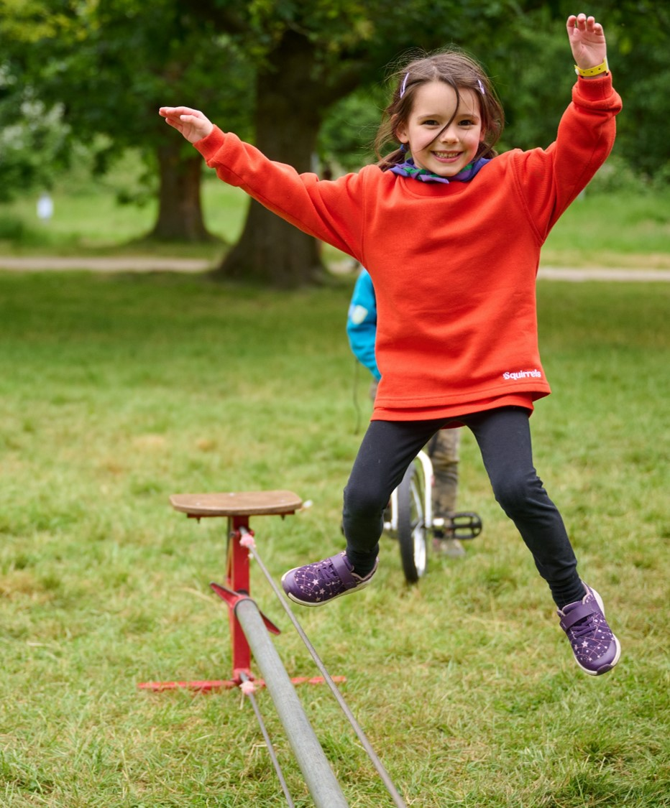
Risk assessments
What is a risk?
This is a word we use a lot, but what does it actually mean...?
You have 3 minutes to write a short description of what you think RISK means. However, you only have 280 characters (the length of a tweet) to explain it.
Notes:
Bonus: What risks can you identify in this image?

Slide 24
Risk assessments
What is a risk?
Risk = An action that can cause harm to you and/or other people.
When do we need a risk assessment?
All venues
All activities
All adventurous activities
All games

Slide 25
Risk Assessments
What is a risk assessment?
It’s the process of…
Thinking about what could go wrong
Considering who could be impacted
Trying to reduce the risk
Recording what you just did
Reviewing it, and making any necessary changes for next time

Slide 26
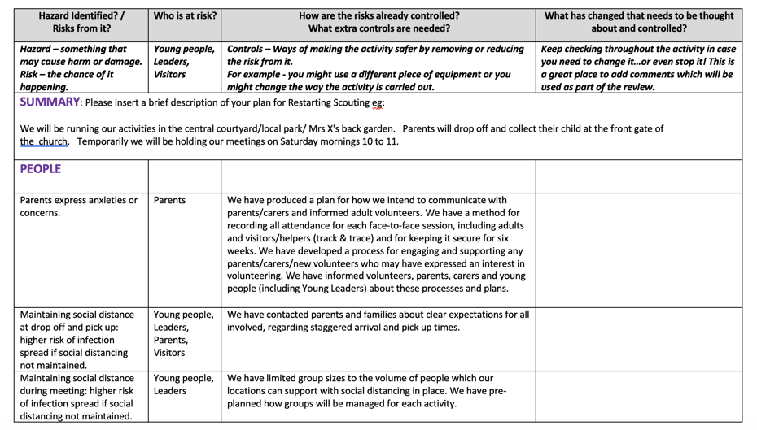
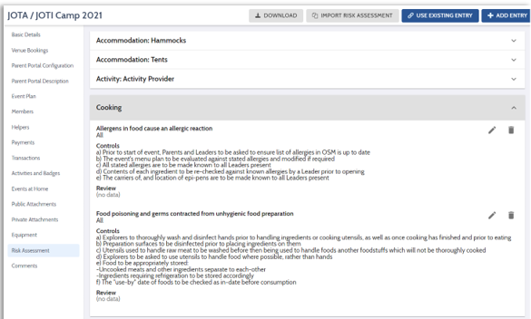
Risk Assessments
In Scouts, all activities should have a written or digital Risk Assessment.

Slide 27
Risk Assessments
Look for a hazard/risk
Add the next four steps...
Record
Review
Who might be harmed/at risk?
Evaluate and control risks
Notes:
Task:
Get the Young Leaders to add the statements to the correct part of the cycle!

Slide 28
Risk Assessments
Look for a hazard/risk
2. Who might be harmed/at risk?
5. Review and repeat
3. Evaluate and control risks
4. Record
Notes:
Answers

Slide 29
So what now ….

Slide 30
The Young Leader Scheme
Module A = Completed!
You've earned your Young Leaders badge and woggle.

Slide 31
The Young Leader Scheme
What's next?
Congratulations on completing module A!
Next up:
There are 10 modules to help you get the most out of being a young leader
You will also complete 4 missions...

Slide 32
The Young Leader Scheme
What are your missions?
Mission 1:
Plan and run a minimum of 3 games, a mix of indoors and outdoors
Mission 2:
Plan and run an activity (not a game)
Mission 3:
Take the section's ideas to a programme planning meeting
Mission 4:
Take responsibility for organising and running part of the programme

Slide 33
The Young Leader Scheme
You will earn a Mission leaf badge when you complete each mission
When you complete all your modules and missions, you will be able to wear the prestigious Young Leader Belt
If you earn the Young Leader Belt, and then become an adult volunteer you’re entitled to wear the Young Leader Adult Recognition Badge for life

Slide 34
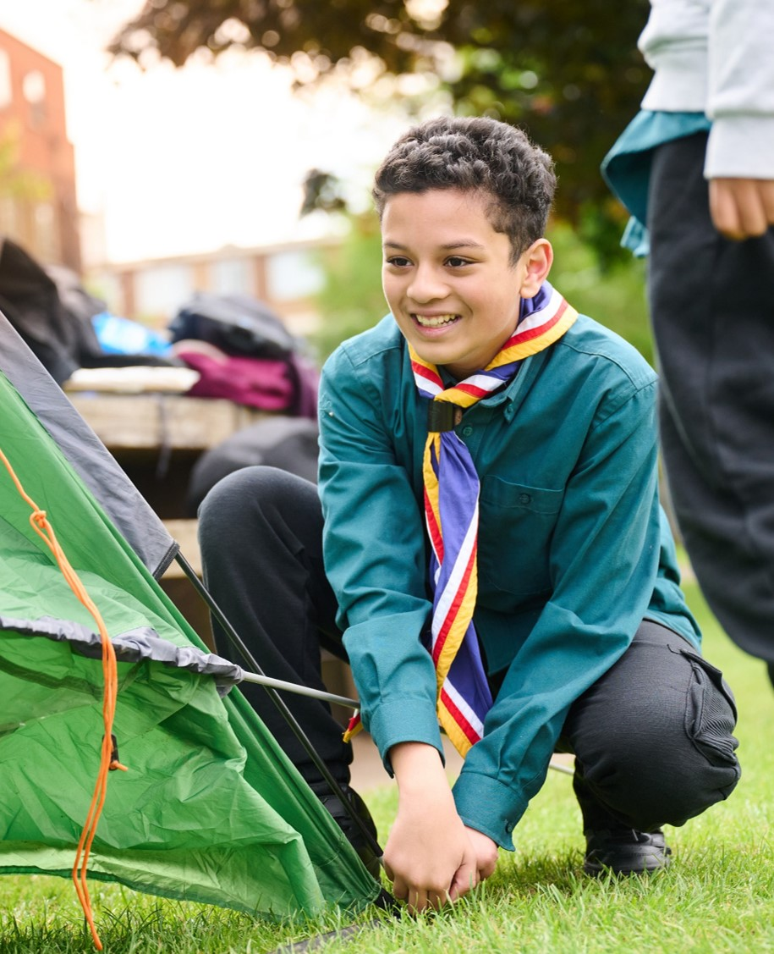
The Young Leader Scheme
Who to contact
If you have any questions, please contact the following people who will be able to help you.
Enter details of County/District contacts here

Slide 35
Thank you
Young Leaders’ Scheme
Scouts.org.uk
#SkillsForLife

