Slide 1
Do more.
Be more.
Young Leaders’ Scheme
Scouts.org.uk
#SkillsForLife
Notes:
If you need to change the background please follow these instructions:
1. On your Windows tablet, tap the Design tab.
2. On your Windows phone, open the slide for editing (either by double-tapping it or by tapping it and then tapping Edit). Tap More at the bottom of your screen, tap Home, and then tap Design.
3. Tap Format Background.
4. You will see the background colours divided into Theme Colours and Standard Colours. Theme colours coordinate with the theme you selected previously. You can select a solid colour or colour gradient.

Slide 2
Explorer Scout Young Leader Training
Module H – Programme Planning

Slide 3
Getting to know you...
Notes:
Icebreaker: 5- 10 mins
Key points:
Participants will be working together during the session so it's a good idea to break the ice and get to know each other first.
Activity option 1 - Speed dating:
Everyone walks around the room, finds someone they don’t know and talk for 1 minute
Ask questions: Who got you into Scouts? When did you join Scouts? What key skill do you bring to your Scout team? what they’d like to learn from workshop,
After two minutes, blow a whistle or shout and they find a new partner
Presenters can come up with other questions if they can think of better ones!
Or alternatively depending on amount or type of participants
Activity option 2 – Group discussion
Participants to discuss above questions (from option 1) within their table groups

Slide 4
Do more. Be more
Welcome
In this session, we are going to look at:
How to plan and deliver a varied programme
Different programme planning tools
Think about what’s important when planning and delivering activities
Do more.
Be more.
Young Leaders’ Scheme

Slide 5
Finding programme ideas Where does inspiration come from?
Notes:
Icebreaker: 5- 10 mins
Key points:
Have everyone write a memory they have of an inspiring activity they did… it could be from their time in scouting, at school, or another group setting.
Activity option 1 - Finding Programme Ideas – 20 mins
Split the group into small teams. On tablecloths, ask the Explorer Scout Young Leaders to write down a list of resources which could help them generate programme ideas.
They might include Activity Finder, Programme Planning tool, internet search engines, magazines, newspapers, District events, County/Area/Region events, books, previous programmes, other leaders, charities, or other Scouting resources.
If there are any methods that the Explorer Scout Young Leaders are not aware of, such as Activity Finder and Programme Planning Tool, then give a short introduction and explain how they can access it.
Alternatively, you could also run this activity as an ‘a-z’, sticking each letter around the room and asking the Explorer Scout Young Leaders to walk around adding as many ideas as possible.
Activity option 2 - Ideas Inspiration – 20 mins
Split the group into small teams, and give each team a bag containing 6-10 random objects.
Ask the Explorer Scout Young Leaders to think of as many games, activities and themes as they can, using each object as a trigger.
Teams should try to be as creative as possible and to come up with the most suggestions. Get each group to feed back some of their ideas.
Then, ask the Explorer Scout Young Leaders to think about how easy or difficult it was to generate new ideas. Highlight the benefits of working together to do this, rather than relying on one person to think of ideas on their own.

Slide 6
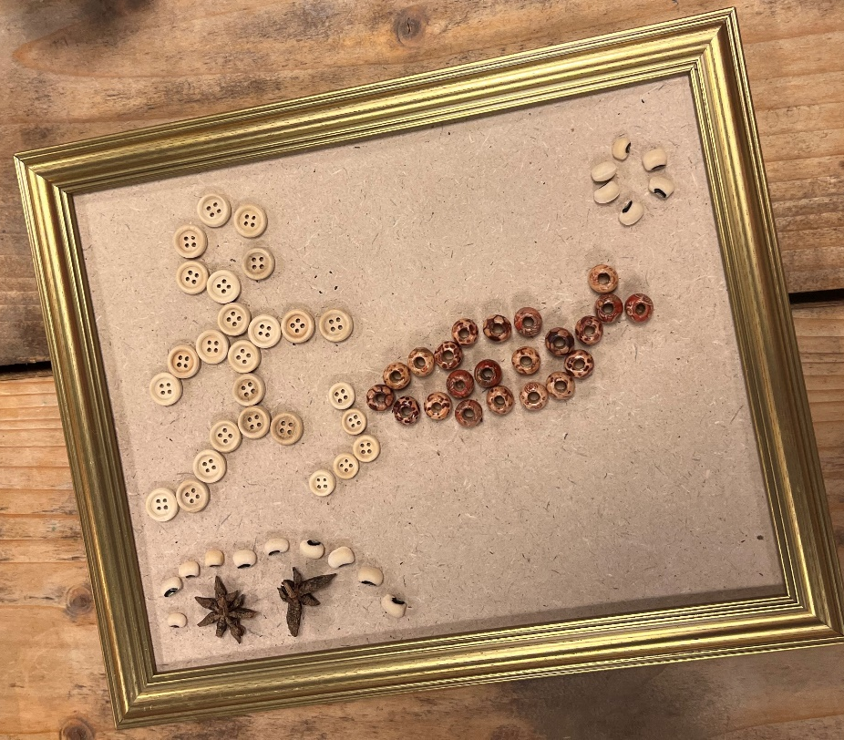
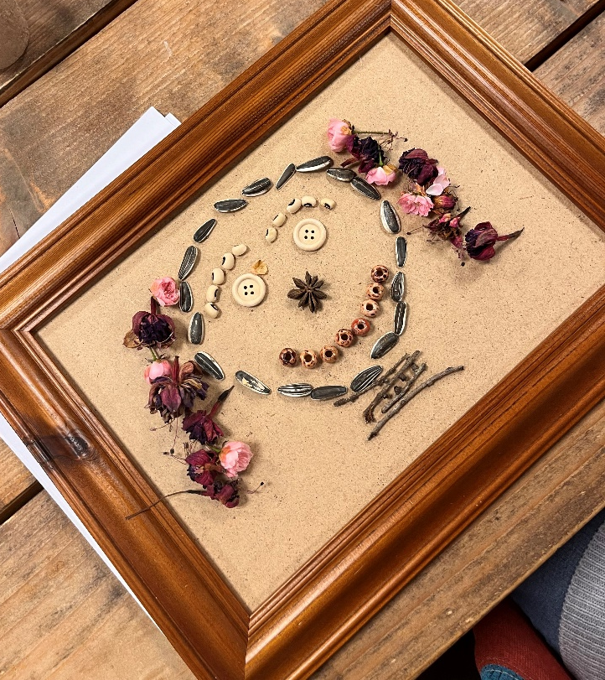
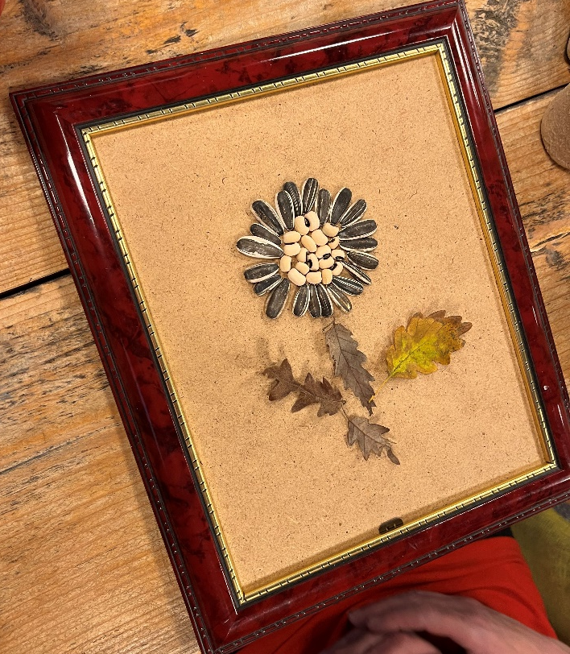
Module H - YLS
Open Ended Sessions for ideas generation
Notes:
Open ended sessions are a great way to find out what different sections are interested in. No fixed time limit, this could be 10 mins or an hour, depending on how you structure the day.
This is an experiential activity for the Explorer Scout Young Leaders to take part in. It will help them generate their own ideas and give them ideas for what they could do in the future.
Resources: stones. Twigs, acorns, seeds and/or other natural objects. Optional empty picture frames.
Let the Explorer Scout Young Leaders engage with the materials. Tell them they have 10/20 minutes to create something using these materials. There are no rules, they can create whatever they want. They can also change their plans as much as they want through the process, and start creating something else.
Once everyone has finished, they will each share what they made with the group.
Some might make a pattern with different stone sizes, some might recreate the shapes of flowers, make a face or a scene.
Once they’ve shared what they made, have everyone come up with different activity ideas they could deliver that build on the ideas that emerged from the open ended sessions.

Slide 7
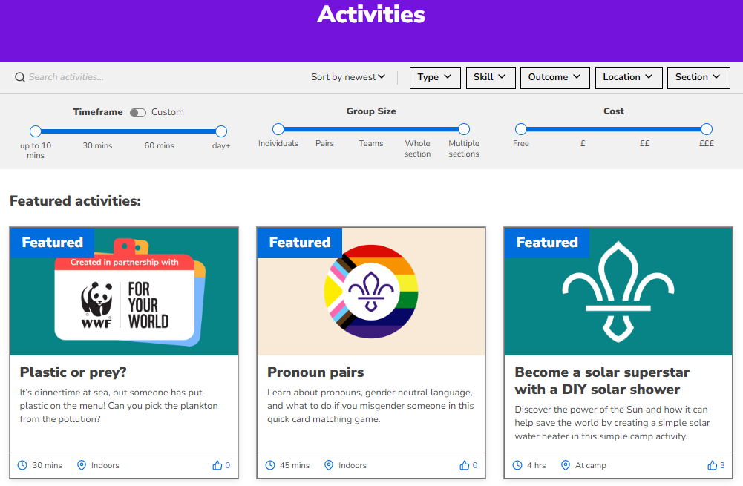
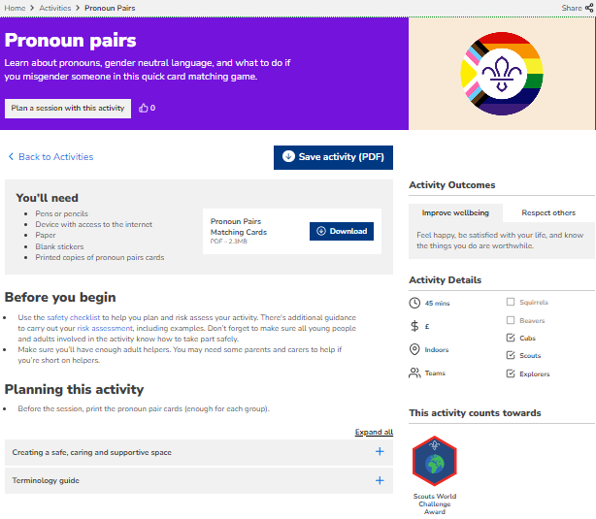
Module H - YLS
What is the Activity Finder
Notes:
If the Explorer Scout Young Leaders do not all know about the activity finder, you could pull it up here.
https://www.scouts.org.uk/activities
Using some of their ideas from the previous activity, have a look at the activity finder and see what you can find. This can help them to see the range of what’s available, what is different for different sections and see where there might be gaps where they could think of their own activity ideas.

Slide 8
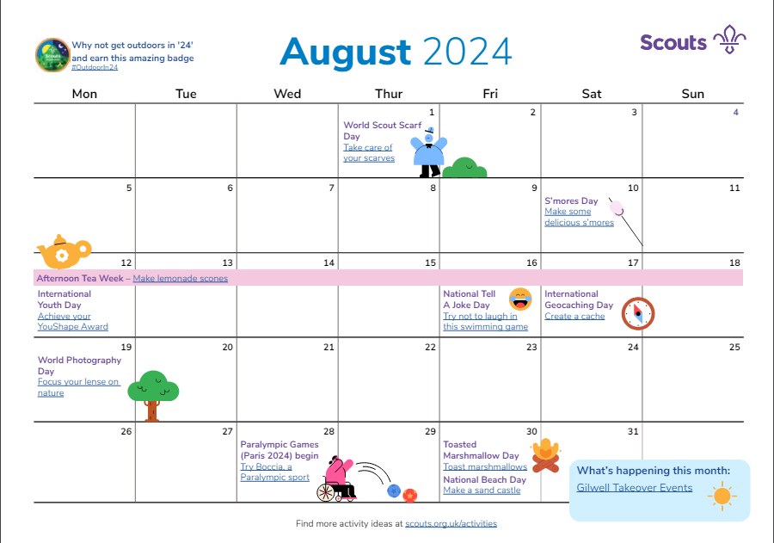
Module H - YLS
Seasonal events
Notes:
Discussion – 10 mins
Have a look at these example calendars of events, then have a discussion. Based on the different cultural holidays, sports events, hobbies, holidays etc that are relevant to the young leaders in the group today… what might they like to plan activities around for the month ahead?
They might do this in small groups or pairs, or as a whole group.

Slide 9
Planning a termly programme
Notes:
In this activity, Explorer Scout Young Leaders can think about how they might plan a termly programme.
Objectives the activity links to:
- understand the concept of running a high quality, balanced programme over a three-month period
- use a range of programme planning techniques
- describe what needs to be considered when planning and running activities
- plan an outline programme for a three-month period
Running the activity – 90 to 120 mins
This exercise is about getting Explorer Scout Young Leaders thinking about longer-term planning, so they can make the programme as exciting and varied as possible. As such, it's worth giving Explorer Scout Young Leaders a fairly large amount of time for this activity, to ensure it's really meaningful. The practice of writing and designing a termly plan is incredibly important.
Split the Explorer Scout Young Leaders into small teams. Give each of them a time of year (spring, summer, autumn, winter), alongside some specific badges to cover. Ask each team to come up with a termly programme, taking the points you have given them into consideration. You can refer to the Occasional Events page for ideas on what to run in different months.
Once they have finished, ask the teams to feed back the programme they have created to the rest of the group. What have they included and why?
Finally, ask the group whether it has made them more aware of the importance of advanced planning. Can they see what problems can arise if individual meetings are organised in isolation? Do they see how a well-planned programme can deliver the balance and the opportunities to complete the various awards?
This exercise should also start Explorer Scout Young Leaders thinking about the importance of:
National, District and County, Area or Region events and activities
major projects and national programme initiatives
activities they’ve done before
new activities they might like to try
Any programme should include things that the section members want to do and, where possible, contribute towards awards and badges. Get teams to pick out three or four activities from their programme. Ask them to list all the things they will need to consider in order to run it. This could include:
travel
permission
transport
equipment
safety
numbers
Get team to feedback one of their activities to the group. As a whole group, they should then make a central list of the key considerations when planning an activity

Slide 10
What do you think?
Notes:
Summarise the module by revisiting the objectives, and asking Explorer Scout Young Leaders whether they feel they have covered all of the objectives satisfactorily. - 5 mins

Slide 11
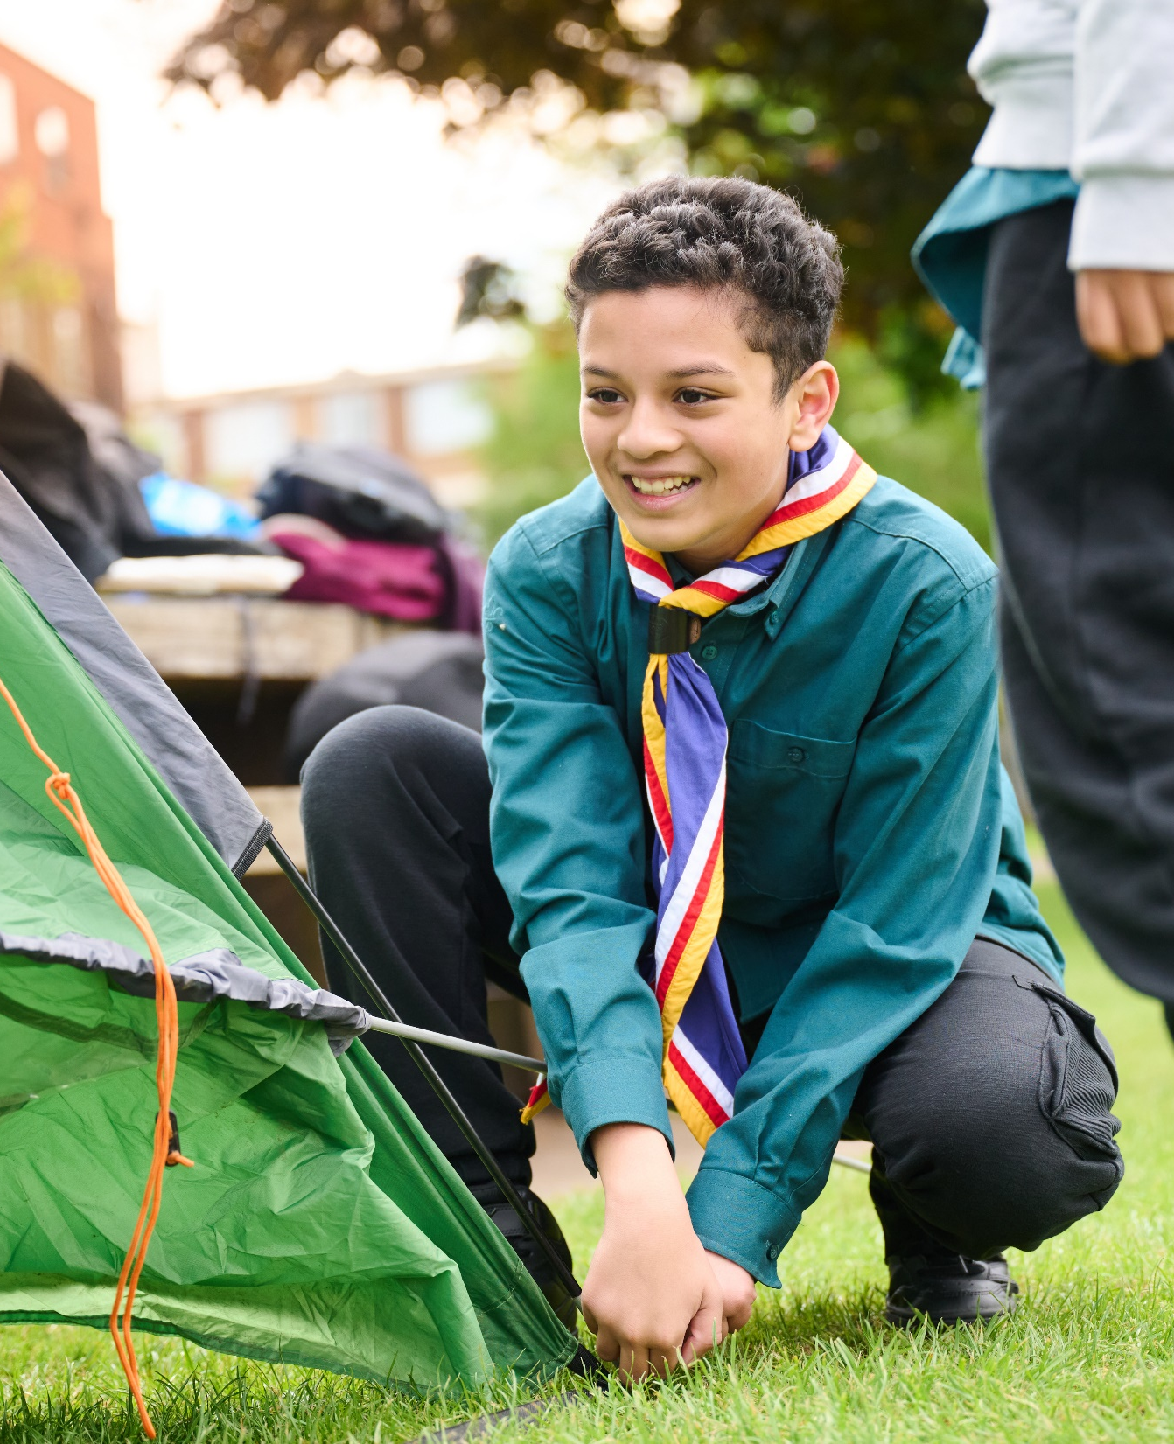
The Young Leader Scheme
Who to contact
If you have any questions, please contact the following people who will be able to help you.
Enter details of County/District contacts here

Slide 12
Thank you
Young Leaders’ Scheme
Scouts.org.uk
#SkillsForLife

